Slide 1
Breast Cancer Index®
Extended Endocrine Therapy Decision-Making in
Early-Stage, HR+ Breast Cancer
Expanded Indication*
Adjuvant Endocrine Therapy and Ovarian Function Suppression
Supplemental Data
Extended Endocrine Therapy
*Not currently available to order.​
The features and results of the Breast Cancer Index Test, to the extent they differ from the information found on the BreastCancerIndex.com website, including, but not limited to, the features concerning adjuvant endocrine therapy and ovarian function suppression: (i) are not currently available for clinical use; (ii) will be made available only after all required internal validations and regulatory requirements have been met; and (iii) is being provided herein for informational purposes only, and shall not be deemed to be an offer of availability.​

Slide 2
Extended Endocrine Therapy Decision-Making in Early-Stage, HR+ Breast Cancer

Slide 3
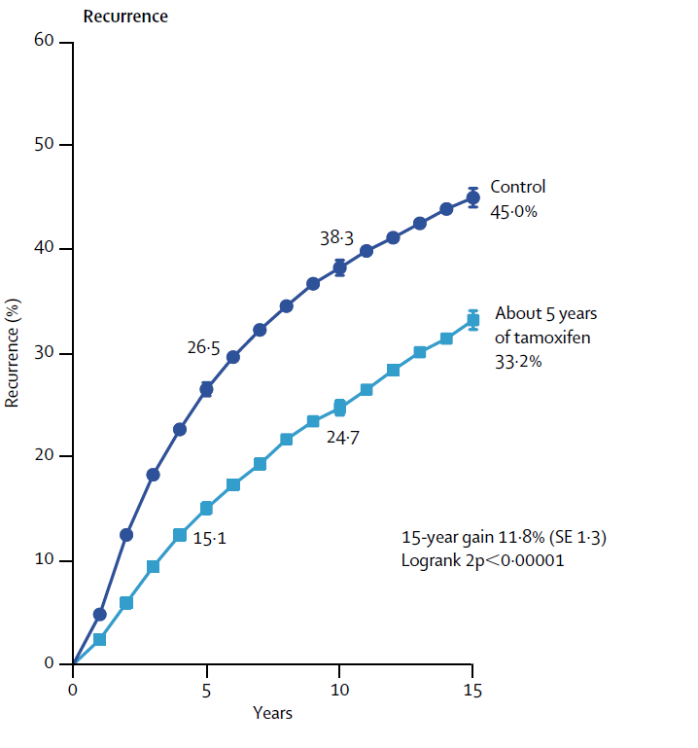
Persistent Risk of Late Recurrence: A Hallmark in HR+ Breast Cancer
Early-stage (I/III) HR+ breast cancer patients have good overall prognosis, but >50% of recurrences occur after 5 years¹⁻³
1. EBCTCG. Lancet 2005;365:1687-1671. 2. Saphner T, et al. J Clin Oncol. 1996;14(10):2738-2746. 3. Pan H, et al. N Engl J Med. 2017;377:1836-1846.

Slide 4
Optimal Duration of Endocrine Therapy: Consistent but Inconclusive Findings Across Trials
THERAPY TYPE + DURATION
 | TRIAL | ADJUVANT | EXTENDED | N | DISEASE-FREE SURVIVAL* | ABSOLUTE BENEFIT
TAM ➔ AI | MA.17¹ | TAM x 5y | → Placebo x 5y → AI x 5y | 2587 2583 | 89.8% 94.4% | 4.6%
 | ABCSG 6A² | TAM x 5y | → Placebo x 3y → AI x 3y | 469 387 | 88.2% 92.9% | 4.7%
TAM ➔ TAM | aTTom³ | TAM x 5y | → No treatment → TAM x 5y | 3485 3468 | 68% 72% | 4%
 | ATLAS⁴ | TAM x 5y | → No treatment → TAM x 5y | 3418 3428 | 74.9% 78.6% | 3.7%
AI ➔ AI | MA.17R⁵ | TAM x 0-5y → AI x 5y | → Placebo → AI x 5y | 959 959 | 91% 95% | 4%
 | NSABP B-42⁶ | AI x 5y | → Placebo x 5y → AI x 5y | 1983 1983 | 72.1% 76.1% | 4%
CONSISTENT
FINDING
6 Trials,
25,000+ Women:
3%-5%
absolute benefit from an additional 5 years of endocrine therapy to prevent any recurrence
*Based on disease-free survival or cumulative risk of recurrence rates as reported in the primary publications (note that the definitions of disease-free were not identical across trials).
1. Goss PE, et al. J Natl Cancer Inst. 2005;97:1262-1271. 2. Jakesz R, et al. J Natl Cancer Inst. 2007;99:1845-1853. 3. Gray R, et al. J Clin Oncol. 2013;31:(suppl;abstr 5). 4. Davies C, et al. Lancet. 2013;381:805-816. 5. Goss PE, et al. N Engl J Med. 2016;375:209-219. 6. Mamounas EP, et al. GS4-01; SABCS. 2019.

Slide 5
Spare Women the Side Effects and Toxicity Associated with Prolonged Treatment if they are Not Likely to Benefit¹⁻³
ADVERSE EVENTS
% INCIDENCE OF BONE EFFECTS
10%
Bone toxicity
Endometrial cancer
Embolisms
Heart disease
(MA.17R²)
Placebo
AI
↑29%
TOLERABILITY CHALLENGES
↑56%
50%
Hot flashes
Sexual dysfunction
Arthralgias
Myalgias
Mild to moderate cognitive impairment
↑83%
1. Davies C, et al. Lancet. 2013;381:805-816. 2. Goss PE, et al. N Engl J Med. 2016;375:209-219. 3. Mamounas EP, et al. S1-05; SABCS. 2016.

Slide 6

Risk ≠ Benefit
Estimating high or low recurrence risk using clinicopathologic factors does NOT predict whether a patient will benefit from extended endocrine therapy
Tumor Size
Tumor Grade
Nodal Status
Quantitative ER/PR
Ki67
CTS5
Other Genomic Assays
X
While clinical and pathologic factors are prognostic, they DO NOT reliably PREDICT benefit from extended endocrine therapy¹⁻⁴
The Breast Cancer Index
genomic assay is the only guideline-recognized test to PREDICT who is likely to benefit from extended endocrine therapy. ^{5,6}
1. Davies C, et al. Lancet. 2013;381:805-816. 2. Goss PE, et al. J Natl Cancer Inst. 2005;97:1262-1271. 3. Goss PE, et al. N Engl J Med. 2016;375:209-219. 4. Mamounas EP, et al. S1-05; SABCS. 2016. 5. Referenced with permission from the NCCN Clinical Practice Guidelines in Oncology (NCCN Guidelines®) for Breast Cancer V.2.2026. © National Comprehensive Cancer Network, Inc. 2026. All rights reserved. Accessed April 6, 2026. To view the most recent and complete version of the guideline, go online to NCCN.org. NCCN makes no warranties of any kind whatsoever regarding their content, use or application and disclaims any responsibility for their application or use in any way. 6. Andre F, et al. J Clin Oncol. Published online April 19, 2022. Referenced with permission from the American Society of Clinical Oncology (ASCO®) Clinical Practice Guideline Biomarkers for Adjuvant Endocrine and Chemotherapy in Early-Stage Breast Cancer. © American Society of Clinical Oncology. 2026. All rights reserved. To view the most recent and complete version of the guideline, go online to https://ascopubs.org/jco/special/guidelines[ascopubs.org]. ASCO makes no warranties of any kind whatsoever regarding their content, use of application and disclaims any responsibility for their application or use in any way.

Slide 7
The Breast Cancer Index Test is the established tool for predicting which patients are likely to benefit from extended endocrine therapy¹⁻⁷
Exclusive guideline recognition^{1,2} | Supported by comprehensive predictive data³⁻⁷
1.Referenced with permission from the NCCN Clinical Practice Guidelines in Oncology (NCCN Guidelines®) for Breast Cancer V.2.2026. © National Comprehensive Cancer Network, Inc. 2026. All rights reserved. Accessed April 6, 2026. To view the most recent and complete version of the guideline, go online to NCCN.org. NCCN makes no warranties of any kind whatsoever regarding their content, use or application and disclaims any responsibility for their application or use in any way. 2. Andre F, et al. J Clin Oncol. Published online April 19, 2022. Referenced with permission from the American Society of Clinical Oncology (ASCO®) Clinical Practice Guideline Biomarkers for Adjuvant Endocrine and Chemotherapy in Early-Stage Breast Cancer. © American Society of Clinical Oncology. 2026. All rights reserved. To view the most recent and complete version of the guideline, go online tohttps://ascopubs.org/jco/special/guidelines[ascopubs.org]. ASCO makes no warranties of any kind whatsoever regarding their content, use of application and disclaims any responsibility for their application or use in any way. 3. Zhang Y, et al. Clin Cancer Res. 2013;19(15):4196-4205. 4. Sgroi DC, et al. J Natl Cancer Inst. 2013;105(14):1036-1042. 5. Bartlett JMS, et al. Clin Cancer Res. 2022;28(9):1871-1880. 6. Noordhoek I, et al. Clin Cancer Res. 2021;27(1):311-319. 7. Mamounas EP, et al. Clin Cancer Res. 2024;30(9):1984-1991.

Slide 8
The Leading Biomarker for Extended Endocrine Therapy
Guideline-recognized.^{1,2} Extensively validated.³⁻⁷ Proven clinical impact.⁸
Breast Cancer Index®
Personalized Care
to treat women based on the individual biology of a tumor
BCI
PREDICTIVE
Predicts which patients are likely to benefit from extended endocrine therapy
BCI
PROGNOSTIC
Assesses individual risk of late distant recurrence
BIOMARKERS
  A Separate Algorithm Based on H/I Biomarker
  Algorithmic Combination of 11 Genes
Estrogen Signaling: HOXB13/IL17BR
BUB1B, CENPA, NEK2, RACGAP1, RRM2
HOXB13/IL17BR
Algorithm for N+ incorporates tumor size and grade
Referenced with permission from the NCCN Clinical Practice Guidelines in Oncology (NCCN Guidelines®) for Breast Cancer V.2.2026. © National Comprehensive Cancer Network, Inc. 2026. All rights reserved. Accessed April 6, 2026. To view the most recent and complete version of the guideline, go online to NCCN.org. NCCN makes no warranties of any kind whatsoever regarding their content, use or application and disclaims any responsibility for their application or use in any way.
Andre F et al. J Clin Oncol. Published online April 19, 2022. Referenced with permission from the American Society of Clinical Oncology (ASCO®) Clinical Practice Guideline Biomarkers for Adjuvant Endocrine and Chemotherapy in Early-Stage Breast Cancer. © American Society of Clinical Oncology. 2026. All rights reserved. To view the most recent and complete version of the guideline, go online to https://ascopubs.org/jco/special/guidelines[ascopubs.org]. ASCO makes no warranties of any kind whatsoever regarding their content, use of application and disclaims any responsibility for their application or use in any way.
3. Zhang Y, et al. Clin Cancer Res. 2013;19(15):4196-4205.
4. Sgroi DC, et al. J Natl Cancer Inst. 2013;105(14):1036-1042.
5. Bartlett JMS, et al. Clin Cancer Res. 2022;28(9):1871-1880.
6. Noordhoek I, et al. Clin Cancer Res. 2021;27(1):311-319.
7. Mamounas EP, et al. Clin Cancer Res. 2024;30(9):1984-1991.
8. Sanft TB, et al. J Natl Compr Canc Netw. 2024;22(2):99-107.

Slide 9
NCCN Clinical Practice Guidelines in Oncology
(NCCN Guidelines®)¹
Guideline Recognition
ASCO® Clinical Practice Guideline²
BINV-N (4 of 5):
Treatment Implications of the Breast Cancer Index Test (BCI)^{e}
In secondary analyses of the MA.17, Trans-aTTom, and IDEAL trials, patients with HR-positive, pT1–T3, pN0 or pN1 (1-3 positive lymph nodes) who had a BCI (H/I) high demonstrated significant improvements in DFS when adjuvant endocrine therapy was extended, compared to the control arm.
Patients with BCI (H/I) low demonstrated a lower risk of distant recurrence (compared to BCI [H/I] high) and no significant improvement in disease-free survival (DFS) or OS compared to the control arm in terms of extending endocrine therapy duration.
For patients with HR-positive, HER-negative, and pN1 tumors (1-3 positive lymph nodes), an optimized BCI model integrating tumor size and grade is prognostic for distant recurrence at 10 years.
BCI may be offered to patients with 0-3 positive nodes who received 5 years of endocrine therapy without evidence of recurrence to guide decisions about extended endocrine therapy
Clinician may offer the BCI test to guide decisions about extended endocrine therapy with either tamoxifen, an AI, or a sequence of tamoxifen followed by AI
OncotypeDX, EndoPredict, Prosigna, Ki67 and IHC4 are identified as having insufficient evidence to guide decisions about extended endocrine therapy
^{e}The benefit of testing BCI (H/I) for extended adjuvant endocrine therapy is unknown in patients who had ovarian function suppression, CDK4/6 inhibitors, or olaparib in addition to adjuvant endocrine therapy.¹
1. Referenced with permission from the NCCN Clinical Practice Guidelines in Oncology (NCCN Guidelines®) for Breast Cancer V.2.2026. © National Comprehensive Cancer Network, Inc. 2026. All rights reserved. Accessed April 6, 2026. To view the most recent and complete version of the guideline, go online to NCCN.org. NCCN makes no warranties of any kind whatsoever regarding their content, use or application and disclaims any responsibility for their application or use in any way. 2. Andre F, et al. J Clin Oncol. Published online April 19, 2022. Referenced with permission from the American Society of Clinical Oncology (ASCO®) Clinical Practice Guideline Biomarkers for Adjuvant Endocrine and Chemotherapy in Early-Stage Breast Cancer. © American Society of Clinical Oncology. 2026. All rights reserved. To view the most recent and complete version of the guideline, go online tohttps://ascopubs.org/jco/special/guidelines[ascopubs.org]. ASCO makes no warranties of any kind whatsoever regarding their content, use of application and disclaims any responsibility for their application or use in any way.

Slide 10
NCCN Guidelines®
Gene expression assays for consideration of adjuvant systemic therapy^{a,b}
Assay | Predictive | Prognostic | NCCN Category of Preference | NCCN Category of Evidence and Consensus
21-gene (Oncotype Dx) (for pN0) | Yes | Yes | Preferred | 1
21-gene (Oncotype Dx) for pN1 (1-3 positive nodes)^{c} | Yes | Yes | Post-menopausal: Preferred | 1
 |  |  | Pre-menopausal: Other | 2A
70-gene (MammaPrint) for pN0 and pN1 (1–3 positive nodes) | Not determined | Yes | Other | 1
50-gene (Prosigna) for pN0 and pN1 (1–3 positive nodes) | Not determined | Yes | Other | 2A
12-gene (EndoPredict) for pN0 and pN1 (1–3 positive nodes) | Not determined | Yes | Other | 2A
Breast Cancer Index (BCI) Test | Predictive of benefit of extended adjuvant endocrine therapy | Yes | Other | 2A
Gene expression assays provide prognostic and therapy-predictive information that complements T, N, M and biomarker information. Use of these assays is not required for staging. The 21-gene assay (Oncotype Dx) is preferred by the NCCN Breast Cancer Panel for prognosis and prediction of chemotherapy benefit. Other prognostic gene expression assays can provide prognostic information but the ability to predict chemotherapy benefit is unknown.
See Special Considerations for Breast Cancer in Men (Sex Assigned Male at Birth) (BINV-J).
In the overall study population of the RxPONDER trial, 10.3% had high grade disease and 9.2% had 3 involved nodes.
Referenced with permission from the NCCN Clinical Practice Guidelines in Oncology (NCCN Guidelines®) for Breast Cancer V.2.2026. © National Comprehensive Cancer Network, Inc. 2026. All rights reserved. Accessed April 6, 2026. To view the most recent and complete version of the guideline, go online to NCCN.org. NCCN makes no warranties of any kind whatsoever regarding their content, use or application and disclaims any responsibility for their application or use in any way.

Slide 11
BCI Testing is Supported by Consistent Predictive Evidence Across 5 Trials and Over 4,700 Patients¹⁻⁵
 | Stockholm¹ | MA.17² | Trans-aTTom³ | IDEAL⁴ | B-42⁵
Study Design | 600 Patients | 249 Patients | 789 Patients | 908 Patients | 2,179 Patients
YES (High Predictive) 38-51% patients | 65% Relative risk reduction (p=0.0005) | 65% Relative risk reduction (p=0.007) | 67% Relative risk reduction (P=0.02) | 58% Relative risk reduction (p=0.0111) | 71%* Relative risk reduction (p=0.003)
NO (Low Predictive) 49-62% patients | No significant benefit (p=0.204) | No significant benefit (p=0.35) | No significant benefit (p=0.58) | No significant benefit (p=0.8354) | No significant benefit* (p=0.28)
Nodal Status | 100% N- | 58% N+ / 42% N- | 100% N+ | 73% N+ / 27% N- | 40% N+ / 60% N-
Conclusion
TAM
AI
TAM
TAM
AI
AI
vs
TAM
R
TAM
R
AI
R
AI
R
No therapy
Placebo
Stop
TAM
AI
AI
TAM
AI
Placebo
2 or 5 Years
Adjuvant
5 Years
Adjuvant
5 Years
Extended
5 Years
Adjuvant
5 Years
Extended
5 Years
Adjuvant
2.5 or 5 Years
Extended
5 Years
Adjuvant
5 Years
Extended
PROOF OF CONCEPT
LEVEL 1B EVIDENCE⁶
*Time-dependent DR analysis >4y post-randomization; primary RFI endpoint not met due to significant powering challenges; Only HER2- subset demonstrated significant treatment to biomarker interaction
†For patients disease-free at year 5.
Breast Cancer Index predictive evidence of endocrine responsiveness
(primary adjuvant therapy)
Breast Cancer Index Test established as consistent, reproducible predictor of benefit from extended endocrine therapy†
1. Zhang Y, et al. Clin Cancer Res. 2013;19(15):4196-4205. 2. Sgroi DC, et al. J Natl Cancer Inst. 2013;105(14):1036-1042. 3. Bartlett JMS, et al. Clin Cancer Res. 2022;28(9):1871-1880. 4. Noordhoek I, et al. Clin Cancer Res. 2021;27(1):311-319. 5. Mamounas EP, et al. Clin Cancer Res. 2024;30(9):1984-1991. 6. Simon RM, et al. J Natl Cancer Inst. 2009;101(21):1446-1452.

Slide 12
Patients may be Over- or Under-Treated without the Use of the Breast Cancer Index Test
40%
of physician treatment recommendations related to EET changed following BCI Testing
Sanft TB, et al. J Natl Compr Canc Netw. 2024; 22(2):99-107.

Slide 13
Not All N1 Patients are at High Risk and Need Longer Treatment
AVOID OVERTREATMENT
In patients assumed to have clinically HIGH RISK disease (N1)
The BCI Test identified 22% as having LIMITED RISK (2.1%) of late distant recurrence¹ and 69% of those were not likely to benefit from extended endocrine therapy²
22%
1. Zhang Y, et al. Clin Cancer Res.2017;23(23):7217-7224. 2. Data on file; pulled from raw, unpublished data in the MGH validation study (Zhang Y, et al. Clin Cancer Res. 2017;23(23):7172-7224).

Slide 14
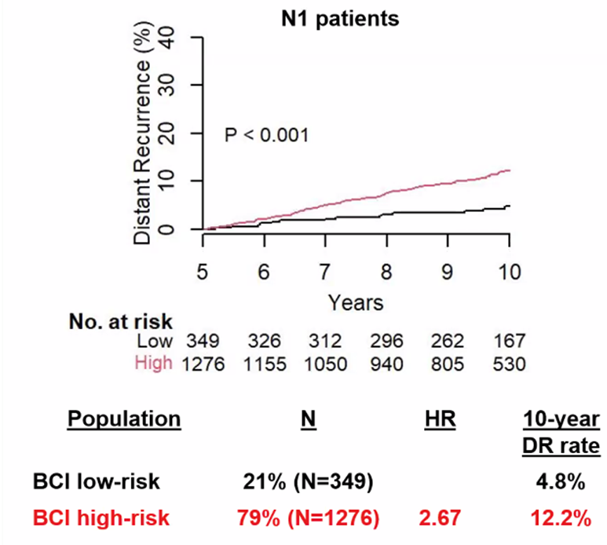
New Larger Study Corroborated the Value of BCI Testing in Identifying N1 Patients at Low Risk of Late Distant Recurrence (DR)
In a study of over 1,600 N1 patients in the TEAM trial, the BCI Test identified 21% as being at low risk of late distant recurrence
Risk of Late DR at 10y
Bartlett JMS, et al. Clin Cancer Res. 2024; 30(8):1509-1517.

Slide 15
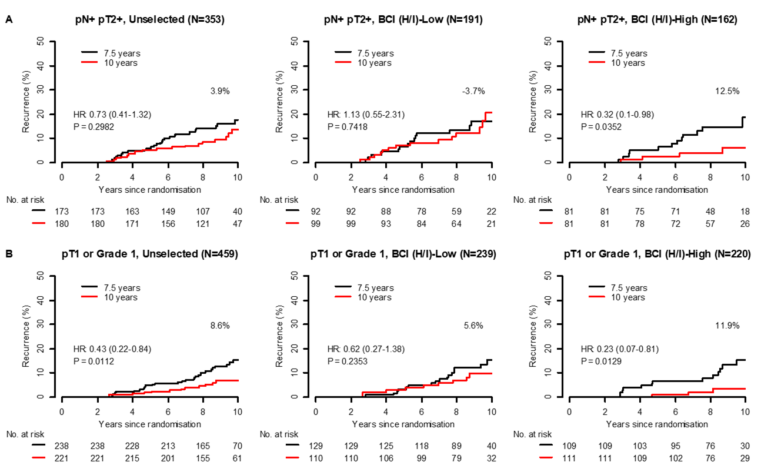
BCI Testing Identified Patients with High-Risk Clinical Features Who Experienced No Benefit from a Full 10 Years of Therapy
The BCI Test identified 54.1% of patients with high-risk clinical features who experienced no benefit from a full 10 years of therapy (p=0.7418)
-3.7%
HR: 1.13 (0.55-2.31)
P=0.7418
Noordhoek I, et al. Clin Cancer Res. 2021;27(1):311-319.

Slide 16
N+ Patients Identified as “No” (H/I Low) Experienced No Benefit from Extended Endocrine Therapy in the Trans-aTTom Study
REDUCTION IN RISK OF RECURRENCE
Absolute Benefit from Extended Endocrine Treatment
No significant benefit (-1.2%)
789 N+ Patients
P Value:
% of Patients:
0.58
0.02
0.40
49%
51%
Bartlett JMS, et al. Clinical Cancer Res. 2022; 28(9):1871-1880.

Slide 17
Assumptions Based on Clinically Low Risk Features May Lead to Potential Under-Treatment
AVOID UNDERTREATMENT
In patients assumed to have clinically
LOW RISK disease (T1N0)
25%
BCI Testing identified 25% as likely to benefit from extended endocrine therapy and at HIGH RISK of late distant recurrence
Schroeder B, et al. NPJ Breast Cancer. 2017;3:28.

Slide 18
The BCI Test Identified Patients with Low-Risk Clinical Features Who Experienced Significant Benefit from a Full 10 Years of Therapy
BCI Testing identified 47.9% of patients with Low risk clinical features who experienced significant benefit from a full 10 years of therapy (p=0.0129)
Noordhoek I, et al. Clin Cancer Res. 2021;27(1):311-319.

Slide 19
Compromising Treatment Length May Mean Compromising Treatment Benefit
Absolute Benefit from Extended Endocrine Treatment (Overall)
Relative Risk Reduction (Overall)
REDUCTION IN RISK OF RECURRENCE
5 YEAR vs 2.5 YEAR EXTENDED AI
For patients who are likely to benefit, a full 10 years of treatment significantly reduced risk of recurrence compared to just 7.5 years in the IDEAL trial
Hazard Ratio | H/I-High HR: 0.42 (0.21-0.84); p=0.0111 H/I-Low HR: 0.95 (0.58-1.56), p=0.8354
Relative Risk Reduction | 58%
P Value | 0.045
No significant benefit (0.5%)
P Value:
% of Patients:
0.0701
0.8354
0.0111
53%
47%
Noordhoek I, et al. Clin Cancer Res. 2021;27(1):311-319.

Slide 20
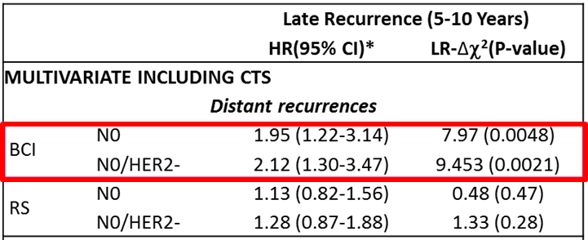
Oncotype DX was Identified by Guidelines as Having Insufficient Evidence to Help Guide Decisions about Extended Endocrine Therapy¹
Study Design: TransATAC cohort assessed head-to-head comparison between the prognostic algorithms of BCI and Oncotype Testing^{2,3}
During years 5-10, Oncotype DX RS was not prognostic for late distant recurrence^{2,3}
BCI Testing significantly prognosticated risk of late distant recurrence (5-10 Years)^{2,3}
  1. Andre F, et al. J Clin Oncol. Published online April 19, 2022. Referenced with permission from the American Society of Clinical Oncology (ASCO®) Clinical Practice Guideline Biomarkers for Adjuvant Endocrine and Chemotherapy in Early-Stage Breast Cancer. © American Society of Clinical Oncology. 2026. All rights reserved. To view the most recent and complete version of the guideline, go online to https://ascopubs.org/jco/special/guidelines[ascopubs.org]. ASCO makes no warranties of any kind whatsoever regarding their content, use of application and disclaims any responsibility for their application or use in any way. 2. Sgroi DC, et al. Lancet Oncol. 2013;14(11):1067-1076. 3. Sestak I, et al. JAMA Oncol. 2018; 4(4):545-553.

Slide 21
BCI Testing Re-Stratified Patients Identified by Oncotype DX as Low Risk to be at High Risk of Late Recurrence
27% of patients were re-stratified by the BCI Test from RS low and intermediate risk categories into high risk of DR
These findings suggest that a proportion of RS low-risk patients may be at an elevated risk of recurrence
27%
Sestak I, et al. Clin Can Res. 2016;22 (20): 5043-5048.

Slide 22
Re-Stratification of Oncotype DX Recurrence Score (RS) Categories by BCI Prediction of EET Benefit
Patients age >50 (N=1,139)
NO CHEMO BENEFIT (Oncotype DX, RS Low)
CHEMO BENEFIT (Oncotype DX, RS High)
29%
39%
29% (N=284/976) of patients were identified by BCI as YES (likely to benefit from EET)
39% (N=63/163) of patients were identified by BCI as NO (not likely to benefit from EET)
Chuy V, et al. SABCS. 2025. Poster [#PS3-07-24].

Slide 23
45% of patients changed their preference related to extended endocrine therapy following BCI Testing
41% of patients said they felt more comfortable with their extended endocrine therapy decision following BCI Testing
“Of course it was disappointing, but I said, now I know I need to stick to it”
– Jelena Rogers (BCI Patient)
Sanft TB, et al. J Natl Compr Canc Netw. 2024; 22(2):99-107.

Slide 24
The Role of BCI Testing in Improving Compliance
REASONS
FOR DISCONTINUATION^{1*}
BCI IMPACT ON PATIENT ADHERENCE²
82%
82% of patients
recommended for extended endocrine therapy stated they would be more likely to be compliant based on the BCI Results²
*In the adjuvant setting
1. Friese CR et al. Breast Can Res Treat 2013; 138(3):931-39. 2. Sanft T, et al. Breast Cancer Management. 2019;8(1).

Slide 25
Breast Cancer Index®
The BCI Test is the only test recognized by ASCO and NCCN Guidelines
to predict which patients are likely to benefit from extended endocrine therapy^{1,2}
Comprehensive validation across 5 predictive studies and over 4,700 patients³⁻⁷
The Breast Cancer Index Test can help avoid under- and over-treatment of patients who may be missed with decision-making based on clinicopathologic factors alone.⁸⁻¹⁰
1.Referenced with permission from the NCCN Clinical Practice Guidelines in Oncology (NCCN Guidelines®) for Breast Cancer V.2.2026. © National Comprehensive Cancer Network, Inc. 2026. All rights reserved. Accessed April 6, 2026. To view the most recent and complete version of the guideline, go online to NCCN.org. NCCN makes no warranties of any kind whatsoever regarding their content, use or application and disclaims any responsibility for their application or use in any way. 2. Andre F, et al. J Clin Oncol. Published online April 19, 2022. Referenced with permission from the American Society of Clinical Oncology (ASCO®) Clinical Practice Guideline Biomarkers for Adjuvant Endocrine and Chemotherapy in Early-Stage Breast Cancer. © American Society of Clinical Oncology. 2026. All rights reserved. To view the most recent and complete version of the guideline, go online tohttps://ascopubs.org/jco/special/guidelines[ascopubs.org]. ASCO makes no warranties of any kind whatsoever regarding their content, use of application and disclaims any responsibility for their application or use in any way. 3. Zhang Y, et al. Clin Cancer Res. 2013;19(15):4196-4205. 4. Sgroi DC, et al. J Natl Cancer Inst. 2013;105(14):1036-1042. 5. Bartlett JMS, et al. Clin Cancer Res. 2022;28(9):1871-1880. 6. Noordhoek I, et al. Clin Cancer Res. 2021;27(1):311-319. 7. Mamounas EP, et al. Clin Cancer Res. 2024;30(9):1984-1991. 8. Zhang Y, et al. Clin Cancer Res.2017;23(23):7217-7224. 9. Data on file; pulled from raw, unpublished data in the MGH validation study (Zhang Y, et al. Clin Cancer Res. 2017;23(23):7172-7224). 10. Schroeder B, et al. NPJ Breast Cancer. 2017;3:28.

Slide 26
Identification of Patients at Minimal Risk of 10-Year Distant Recurrence*
Postmenopausal Patients: Identify which patients are at Minimal Risk† of 10-year distant recurrence who may be spared side effects and adverse events with a shorter duration or omission of endocrine therapy^{1,2*†}
Premenopausal Patients: Identify which patients are at Minimal Risk† of recurrence without the addition of ovarian function suppression (OFS) to primary adjuvant endocrine therapy³*†
†Early-stage, HR+, N0 patients with <5% risk of 10-year distant recurrence

Slide 27
A New BCI™ Minimal Risk Result*
Identification and validation of a new BCI Prognostic cut point†
Stockholm
Untreated¹
Stockholm
Treated¹
NCR
Untreated¹
NCR
Treated²
TEAM²
Minimal risk cut point determined †
Adjusted BCI model validation
Adjusted BCI model validation
Adjusted BCI model validation
Adjusted BCI model validation
†Early-stage, HR+, N0 patients with <5% risk of 10-year distant recurrence, even without receiving adjuvant endocrine therapy

Slide 28
Minimal Risk Identification and Validation: Postmenopausal Patients
Evaluated across prospective-retrospective studies with over 4,000 patients
Postmenopausal, early-stage, HR+, N0, no adjuvant chemotherapy
10-Year Distant Recurrence (%)
Study | N | Endocrine Regimen | % of Patients | Minimal Risk | 95% CI
Training Set¹ Stockholm¹ | 283 | Untreated | 17.3 | 2.3 | 0.0-6.6
 | 317 | 2 or 5 years of TAM | 22.1 | 4.3 | 0.0-9.0
NCR^{1, 2} | 1,245 | Untreated | 16.4 | 4.5 | 2.2-8.0
 | 1,264 | Treated (5 years of TAM, AI, or a sequence of TAM followed by AI) | 13.7 | 4.8 | 2.3-8.9
TEAM² | 978 | 5 years of AI or a sequence of TAM followed by AI | 15.4 | 3.8 | 0.4-7.0
SUMMARY | 4,087 |  | 13-22% | <5%
Level 1B Evidence³
13-22% of postmenopausal patients were classified as BCI Minimal Risk
Across studies, patients identified as BCI Minimal Risk experienced <5% risk of 10-year distant recurrence

Slide 29
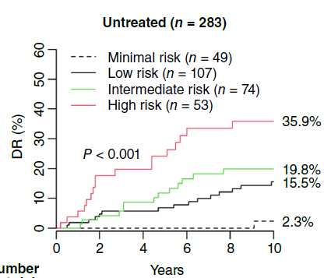
Stockholm Untreated: Training Set
Postmenopausal, early-stage, HR+, N0, no adjuvant chemotherapy
Characteristics | Stockholm Untreated (N=283)
Endocrine Treatment
Age Range | 50-74
Tumor Size (%)
≤2 cm >2 cm | 81.3 18.0
Tumor Grade (%)
1 2 3 | 24.4 61.8 13.8
HER2 Status (%)
HER2- HER2+ | 90.8 9.2
Disease Recurrence (%)
Locoregional Distant | 11.0 19.8
No therapy
2.3% 10-year distant recurrence
17.3% of patients
17.3% of postmenopausal patients classified as Minimal Risk with 2.3% risk of 10-year distant recurrence
Jilderda MF, et al. Clin Cancer Res. 2025;3;31(11):2222-2229.

Slide 30
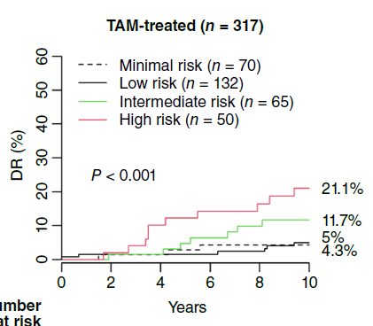
Stockholm Treated: Validation Set
Postmenopausal, early-stage, HR+, N0, no adjuvant chemotherapy
Characteristics | Stockholm Treated (N=317)
Endocrine Treatment
Age Range | 50-74
Tumor Size (%)
≤2 cm >2 cm | 81.7 17.4
Tumor Grade (%)
1 2 3 | 21.1 66.6 12.3
HER2 Status (%)
HER2- HER2+ | 93.1 6.9
Disease Recurrence (%)
Locoregional Distant | 7.9 10.4
TAM
2-5 years
4.3% 10-year distant recurrence
22.1% of patients
22.1% of postmenopausal patients classified as Minimal Risk with 4.3% risk of 10-year distant recurrence
Jilderda MF, et al. Clin Cancer Res. 2025;3;31(11):2222-2229.

Slide 31
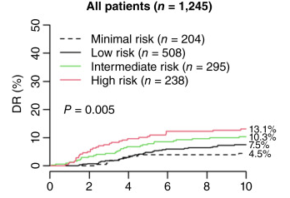
NCR Untreated: Validation Set
Postmenopausal, early-stage, HR+, N0, no adjuvant chemotherapy
Characteristics | NCR Untreated (N=1,245)
Endocrine Treatment
Age Range | ≥70
Tumor Size (%)
≤2 cm >2 cm | 55 45
Tumor Grade (%)
1 2 3 | 22.2 60.7 17.0
HER2 Status (%)
HER2- HER2+ | 94.1 5.9
Disease Recurrence (%)
Locoregional Distant | 4.3 8.6
No therapy
4.5% 10-year distant recurrence
16.4% of patients
16.4% of postmenopausal patients classified as Minimal Risk with 4.5% risk of 10-year distant recurrence
NCR = Netherlands Cancer Registry
Jilderda MF, et al. Clin Cancer Res. 2025;3;31(11):2222-2229.

Slide 32
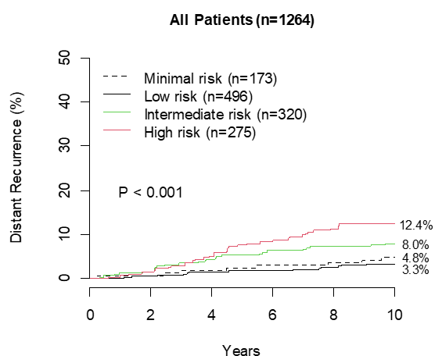
NCR Treated: Validation Set
Postmenopausal, early-stage, HR+, N0, no adjuvant chemotherapy
Characteristics | NCR Treated (N=1,264)
Endocrine Treatment
Age Range | ≥70
Tumor Size (%)
≤2 cm >2 cm | 50.5 49.5
Tumor Grade (%)
1 2 3 | 21.5 60.8 17.6
HER2 Status (%)
HER2- HER2+ | 100 0.0
Disease Recurrence (%)
Locoregional Distant | 2.1 6.6
TAM
AI
TAM
AI
5 Years
4.8% 10-year distant recurrence
13.7% of patients
13.7% of postmenopausal patients classified as Minimal Risk with 4.8% risk of 10-year distant recurrence
NCR = Netherlands Cancer Registry
Jilderda MF, et al. npj Breast Cancer. 2026; 12(1):21.

Slide 33
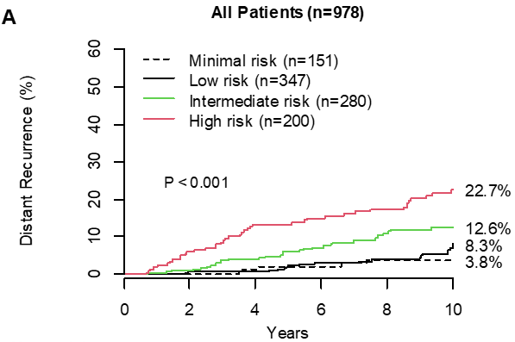
TEAM: Validation Set
Postmenopausal, early-stage, HR+, N0, no adjuvant chemotherapy
Characteristics | TEAM (N=978)
Endocrine Treatment
Age Range | 50-80+
Tumor Size (%)
≤2 cm >2 cm | 54 45.9
Tumor Grade (%)
1 2 3 | 3.9 55.6 36.4
HER2 Status (%)
HER2- HER2+ | 100 0.0
Disease Recurrence (%)
Locoregional Distant | 2.7 9.5
AI
TAM
AI
5 Years
3.8% 10-year distant recurrence
15.4% of patients
15.4% of postmenopausal patients classified as Minimal Risk with 3.8% risk of 10-year distant recurrence
TEAM = Tamoxifen Exemestane Adjuvant Multinational Trial
Jilderda MF, et al. npj Breast Cancer. 2026; 12(1):21.

Slide 34
Minimal Risk Validation: Premenopausal Patients
Validated across 2 prospective-retrospective cohorts with >2,000 patients
Premenopausal, early-stage, HR+, N0, 35-40% received chemotherapy
 |  |  | 10-Year Distant Recurrence (%)
Study Name | N | Treatment | % of Patients | Minimal Risk | 95% CI
SOFT¹ | 383 | 5 years of TAM | 16.2 | 3.5 | 0.9-13.3
 | 727 | 5 years of OFS + TAM/AI | 18.6 | 1.7 | 0.4-6.6
TEXT¹ | 915 | 5 years of OFS + TAM/AI | 19.6 | 2.0 | 0.7-6.2
SUMMARY | 2,025 |  | 16-20% | <5%
Level 1B Evidence²
16-20% of premenopausal patients across trials were classified as Minimal Risk
Across studies, patients identified as Minimal Risk experienced <5% risk of 10-year distant recurrence

Slide 35
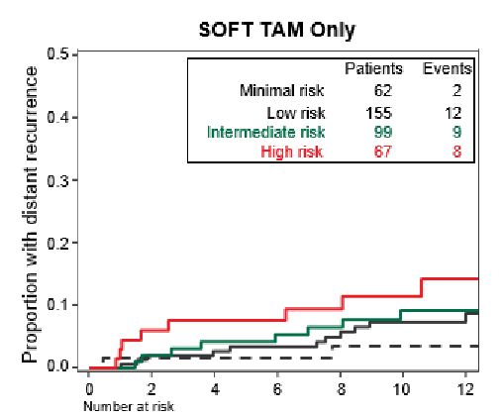
SOFT: Validation Set, TAM Only Treated Arm
Premenopausal, early-stage, HR+, N0
Characteristics | SOFT TAM Only (N=383)
Endocrine Treatment
Age Range | <35-50+
Tumor Size (%)
≤2 cm >2 cm | 74.2 24.5
Tumor Grade (%)
1 2 3 | 28.2 50.7 20.1
HER2 Status (%)
HER2- HER2+ | 88.0 9.1
Adjuvant Chemotherapy (%) | 37.3
TAM
5 years adjuvant
3.5% 10-year distant recurrence
16.2% of patients
16.2% of premenopausal patients classified as Minimal Risk with 3.5% risk of 10-year distant recurrence
SOFT = Suppression of Ovarian Function Trial, OFS=Ovarian Function Suppression
O'Regan RM, et al. Breast. 2026;86:104714.

Slide 36
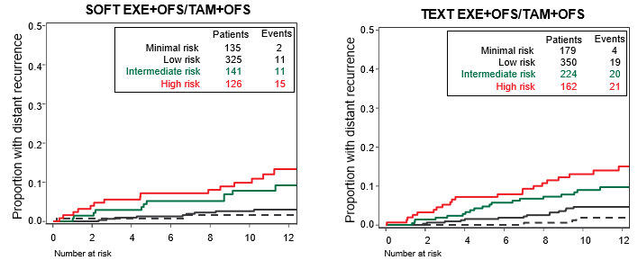
SOFT: Validation Set, OFS Treated Arm
Premenopausal, early-stage, HR+, N0
Characteristics | SOFT OFS Treated (N=727)
Endocrine Treatment
Age Range | <35-50+
Tumor Size (%)
≤2 cm >2 cm | 74.3 25.3
Tumor Grade (%)
1 2 3 | 30.1 52.3 16.2
HER2 Status (%)
HER2- HER2+ | 89.0 8.9
Adjuvant Chemotherapy (%) | 34.7
OFS
AI
OFS
TAM
5 Years Adjuvant
1.7% 10-year distant recurrence
18.6% of patients
18.6% of premenopausal patients classified as Minimal Risk with 1.7% risk of 10-year distant recurrence
SOFT = Suppression of Ovarian Function Trial; OFS=Ovarian Function Suppression
O'Regan RM, et al. Breast. 2026;86:104714.

Slide 37
TEXT: Validation Set, OFS Treated Arm
Premenopausal, early-stage, HR+, N0
Characteristics | TEXT OFS Treated (N=915)
Endocrine Treatment
Age Range | <35-50+
Tumor Size (%)
≤2 cm >2 cm | 70.6 29.0
Tumor Grade (%)
1 2 3 | 18 59.2 22.3
HER2 Status (%)
HER2- HER2+ | 86.9 12.6
Adjuvant Chemotherapy (%) | 40.4
OFS
AI
OFS
TAM
5 Years Adjuvant
2.0% 10-year distant recurrence
19.6% of patients
19.6% of premenopausal patients classified as Minimal Risk with 2.0% risk of 10-year distant recurrence
TEXT = Tamoxifen and Exemestane Trial​; OFS=Ovarian Function Suppression
O'Regan RM, et al. Breast. 2026;86:104714.

Slide 38
The Breast Cancer Index Intended Use and Limitations
The Breast Cancer Index Risk of Recurrence and Extended Endocrine Benefit Test (BCI) is indicated for use in women diagnosed with hormone receptor-positive (HR+), lymph node-negative (LN-) or lymph node-positive (LN+; with 1-3 positive nodes) early-stage, invasive breast cancer, who are distant recurrence-free.
The BCI test provides: 1) a quantitative estimate of the risk for both late (post-5 years from diagnosis) distant recurrence and of the cumulative distant recurrence risk over 10 years (0-10y) in patients treated with adjuvant endocrine therapy (LN-patients) or adjuvant chemoendocrine therapy (LN+ patients), and 2) prediction of the likelihood of benefit from extended (>5 year) endocrine therapy. BCI results are adjunctive to the ordering physician’s workup; treatment decisions require correlation with all other clinical findings. This test was developed and its performance characteristics determined by Biotheranostics, Inc. lt has not been cleared or approved by the U.S. Food and Drug Administration. This test is used for clinical purposes,and should not be regarded as experimental or investigational. How this information is used to guide patient care is the responsibility of the treating provider. Biotheranostics is certified under the Clinical Laboratory Improvement Amendments of 1988 to perform high complexity clinical laboratory testing.

Slide 39
Supplemental Data:
Extended Endocrine Therapy

Slide 40
The Core Difference Between Predictive and Prognostic Tests
PREDICTIVE
PROGNOSTIC
Provides information about the effect of a therapeutic intervention
VS.
Provides information about the patient’s overall cancer outcome, regardless of therapy
Few tests are predictive –
and they are extremely valuable
Many tests are prognostic
Oldenhuis CN, et al. Eur J Cancer 2008;44(7):946-953.

Slide 41
No Significant Correlation Between CTS5 and BCI Data Presented at SABCS 2023
BCI (H/I) is largely independent of CTS5
34.8% of CTS5 Low Risk patients were classified as BCI (H/I)-High
49.7% of CTS5 High Risk patients were classified as BCI (H/I)-Low
26.3% of all patients were classified as CTS5 Intermediate, an ambiguous risk category
57.8% and 42.2% of CTS5 Intermediate Risk patients were classified as BCI (H/I)-Low and BCI (H/I)-High, respectively
Dempsey N, et. Al. Cancer Res (2024) 84 (9_Supplement): PO1-02-03.
1. Dempsey N et al. SABCS. 2023. PO1-02-03.

Slide 42
MA.17: Validation Study
58% of patients were node-positive (N+)
Study Design
Absolute Benefit from Extended Endocrine Treatment
Relative Risk Reduction
249 PATIENTS*
REDUCTION IN RISK OF RECURRENCE
EXTENDED AI vs PLACEBO
AI
Hazard Ratio | H/I-High OR: 0.35 (0.16-0.75); p=0.007 H/I-Low OR: 0.68 (0.31-1.52), p=0.35
Relative Risk Reduction | 65%
P Value | 0.03
No significant benefit (4%)
TAM
R
Placebo
5 Years Adjuvant
5 Years Extended
P Value:
% of Patients:
0.35
0.007
51%
49%
*Case controlled design included 31% of all recurrences in patient trial, giving it the statistical power of study with 2,600 patients.
Sgroi DC, et al. J Natl Cancer Inst. 2013;105(14):1036-1042.

Slide 43
IDEAL: Validation Study
73% of patients were node-positive (N+)
Study Design
Absolute Benefit from Extended Endocrine Treatment (Overall)
Relative Risk Reduction (Overall)
908 PATIENTS
REDUCTION IN RISK OF RECURRENCE
5 YEAR vs 2.5 YEAR EXTENDED AI
Hazard Ratio | H/I-High HR: 0.42 (0.21-0.84); p=0.0111 H/I-Low HR: 0.95 (0.58-1.56), p=0.8354
Relative Risk Reduction | 58%
P Value | 0.045
TAM
AI
No significant benefit (0.5%)
AI
R
TAM
AI
AI
P Value:
% of Patients:
0.0701
0.8354
0.0111
5 Years Adjuvant
2.5 or 5 Years Extended
53%
47%
Noordhoek I, et al. Clin Cancer Res. 2021;27(1):311-319.

Slide 44
IDEAL: Validation Study
Extended AI Validation
Study Design
Absolute Benefit from Extended Endocrine Treatment (Any AI)
Relative
Risk Reduction (Any AI)
794 PATIENTS
REDUCTION IN RISK OF RECURRENCE
5 YEAR vs 2.5 YEAR EXTENDED AI
Hazard Ratio | H/I-High HR: 0.34 (0.16-0.73); p=0.0036 H/I-Low HR: 0.90 (0.53-1.55), p=0.7116
Relative Risk Reduction | 66%
P Value | 0.025
TAM
AI
No significant benefit (1.0%)
AI
R
TAM
AI
AI
P Value:
% of Patients:
5 Years Adjuvant
2.5 or 5 Years Extended
0.0271
0.7116
0.0036
53%
47%
Noordhoek I, et al. Clin Cancer Res. 2021;27(1):311-319.

Slide 45
Trans-aTTom: Validation study
100% of patients were node-positive (N+)
Study Design
Absolute Benefit from Extended Endocrine Treatment
Relative Risk Reduction
789 N+ PATIENTS
REDUCTION IN RISK OF RECURRENCE
EXTENDED TAM vs STOP
TAM
Hazard Ratio | H/I-High HR: 0.33 (0.14-0.75); p=0.02 H/I-Low HR: 1.11 (0.76-1.64), p=0.58
Relative Risk Reduction | 67%
P Value | 0.04
No significant benefit (-1.2%)
TAM
R
Stop
P Value:
% of Patients:
0.58
0.02
0.40
5 Years Adjuvant
5 Years Extended
49%
51%
Bartlett JMS, et al. Clin Cancer Res. 2022; 28(9):1871-1880.

Slide 46
NSABP B-42: Parent Study
Trial Design
(n=3903)
Absolute Benefit from
Extended Endocrine Treatment
3.3%
Absolute DFS
Benefit
AI
AI
R
TAM
AI
Placebo
5 Years Adjuvant
5 Years Extended
Distant Recurrence (DR): 1.8% absolute benefit (HR=0.72, p=0.01)
Mamounas EP, et al. S1-05; SABCS. 2016.

Slide 47
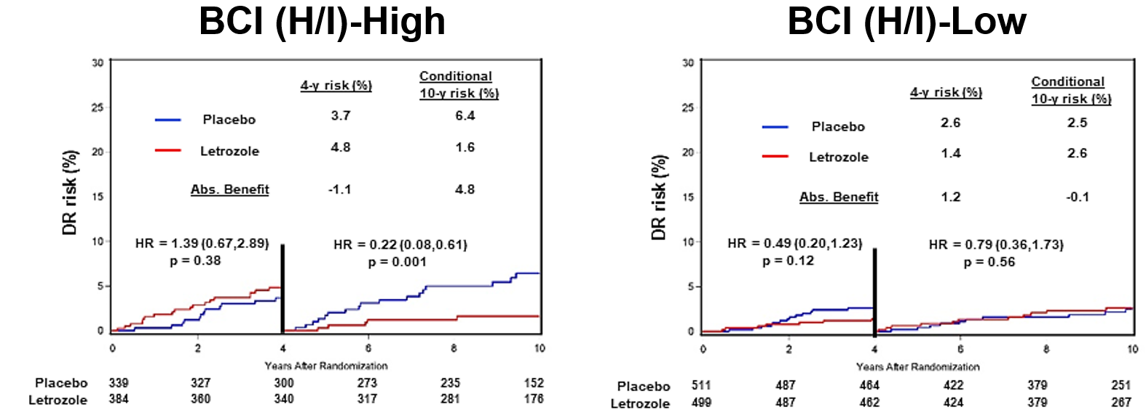
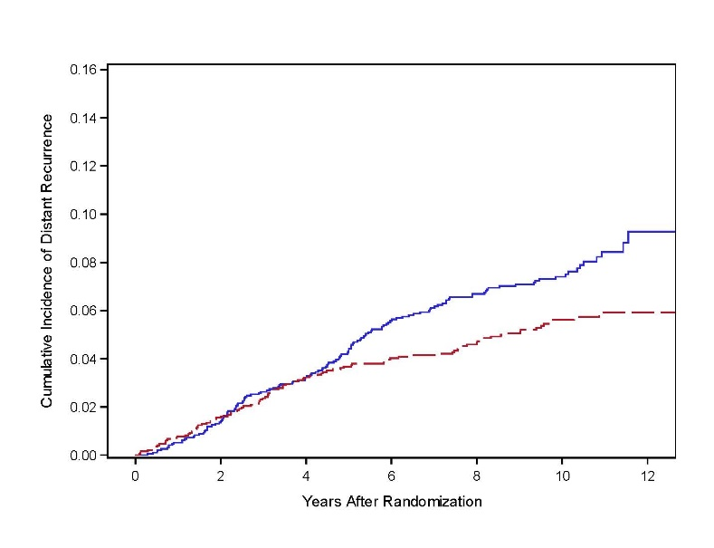
Understanding the BCI B-42 Validation Study
The BCI B-42 translational study did not meet its primary endpoint (RFI)¹:
    Post-hoc analysis showed 50% powering for RFI endpoint¹ (compared with 88% in IDEAL)​
    The DFS benefit observed in NSABP B-42 was primarily driven by prevention of contralateral/new breast primaries²
    In the B-42 parent trial, a delayed treatment effect of extended AI on DR was observed at around 4 years after randomization²
        This is consistent with the carryover effect seen in other EET trials​ such as aTTom³ and ATLAS⁴
        Proportional hazard assumption was not satisfied for BCI (H/I)-High group (p=0.016)¹
Time dependent analysis demonstrated statistically significant extended AI benefit for DR prevention in BCI (H/I)-High patients; similar to previous studies¹
BCI significantly predicted extended AI benefit for DR prevention¹
B-42 Parent Trial²
Placebo
Letrozole
Curves start to
separate
HER2-
1. Mamounas EP, et al. 501; ASCO. 2021 2. Mamounas EP, et al. GS4-01; SABCS. 2019. 3. Gray R, et al. J Clin Oncol. 2013;31:(suppl;abstr 5). 4. Davies C, et al. Lancet. 2013;381:805-816.

Slide 48
B-42: Validation Study
Presented at ASCO 2021
40% of patients were node-positive (N+)
Study Design
Relative Risk Reduction
2179 PATIENTS
EXTENDED AI VS. PLACEBO
Consistent with previous studies, BCI identified patients with statistically significant benefit for
DR prevention (BCI YES, H/I High)*
Hazard Ratio | H/I-High HR: 0.29 (0.12-0.69); p=0.003 H/I-Low HR: 0.68 (0.33-1.39), p=0.28
Relative Risk Reduction | 71%*
AI
AI
R
TAM
AI
Placebo
5 Years Adjuvant
5 Years Extended
*Time-dependent DR analysis >4y post-randomization; primary RFI endpoint not met due to significant powering challenges; Only HER2- subset demonstrated significant treatment to biomarker interaction
Mamounas EP, et al. 501; ASCO. 2021.

Slide 49
Studies Evaluating the BCI Test in HER2 Subsets
Predictive Studies | HR+/HER2- | HR+/HER2+ | HR+/HER2? | HER2+ interaction p-value
Stockholm¹ (n=600) | 552 (92%) | 48 (8%) | N/A | ND
MA17² (n=249) | 226 (91%) | 23 (9%) | N/A | 0.98*
Trans-aTTom³ (n=789; N+) | 711 (90%) | 78 (10%) | N/A | 0.85†
IDEAL⁴ (n=908) | 302 (33%) | 79 (9%) | 527 (58%) | ND
Prognostic Studies | HR+/HER2- | HR+/HER2+ | HR+/HER2? | HER2+ interaction p-value
Stockholm¹ (n=600) | 552 (92%) | 48 (8%) | N/A | 0.67‡
Multi-Institutional¹ (n=358) | 316 (88%) | 42 (12%) | N/A | 0.09§
Trans-ATAC⁵ (n=665) | 597 (90%) | 68 (10%) | N/A | ND
N1 cohort⁶ (n=402) | 259 (64%) | 52 (13%) | 91 (23%) | ND
1. Zhang Y, et al. Clin Cancer Res. 2013;19(15):4196-4205. 2. Sgroi DC, et al. J Natl Cancer Inst. 2013;105(14):1036-1042. 3. Bartlett JMS, et al. Clin Cancer Res. 2022; 28(9):1871-1880. 4. Noordhoek I, et al. Clin Cancer Res. 2021;27(1):311-319. 5. Sgroi DC, et al. Lancet Oncol. 2013;14(11):1067-1076. 6. Zhang Y, et al. Clin Cancer Res. 2017;23(23):7217-7224.

Slide 50
Prognostic Evidence Across 5 Trials
Prognostic Validation of the Breast Cancer Index Test in Evaluating Risk of Late Distant Recurrence (Years 5-10)
NODE NEGATIVE VALIDATION
(N0)
NODE POSITIVE VALIDATION
(N1. 1-3 POSITIVE NODES)
NODE POSITIVE AND NEGATIVE VALIDATION
Stockholm RCT 2013¹ | Multi-institutional 2013¹ | TransATAC RCT 2013² | N1 Validation 2017³
Validation in Prospective RCT | Validation in Multi-institutional, cohort | Validation in Prospective RCT and Head-to-Head with Oncotype Dx | Retrospective validation with Massachusetts General Hospital
317 Patients | 358 Patients | 665 Patients | 402 Patients
Post-menopausal | Pre-and Post-menopausal | Post-menopausal | Pre-and Post-menopausal
TAM | TAM | TAM or AI | TAM or AI
TEAM⁴
Retrospective validation of the Tamoxifen and Exemestane Adjuvant Multinational (TEAM) trial
3,053 Patients
Post-menopausal
TAM or AI
58% node-positive (N+)
1. Zhang Y, et al. Clin Cancer Res. 2013;19(15):4196-4205. 2. Sgroi DC, et al. Lancet Oncol. 2013;14(11):1067-1076. 3. Zhang Y, et al. Clin Cancer Res. 2017;23(23):7217-7224.4. Bartlett, et al. ESMO. 2022.

Slide 51
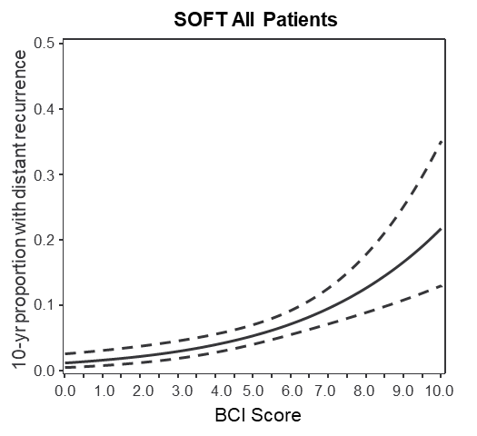
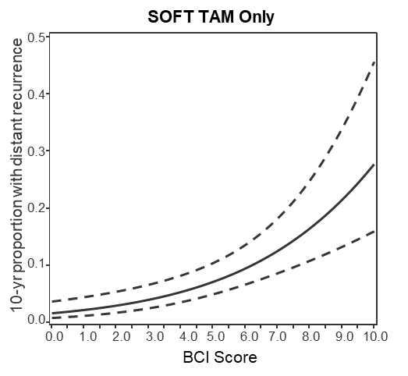
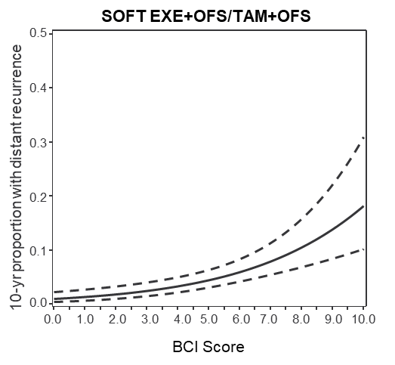
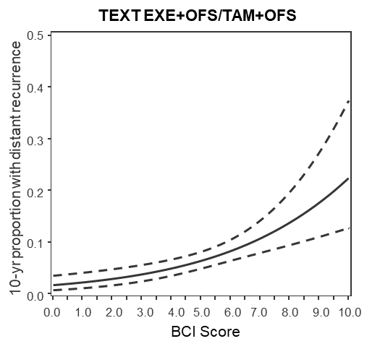
Relation of Continuous BCI Score and Distant Recurrence Risk in the SOFT and TEXT N0 Cohorts
The 10-year risk of distant recurrence increased as the BCI score increased for all patients combined and by treatment assignment
O'Regan RM, et al. Breast. 2026;86:104714.

Slide 52
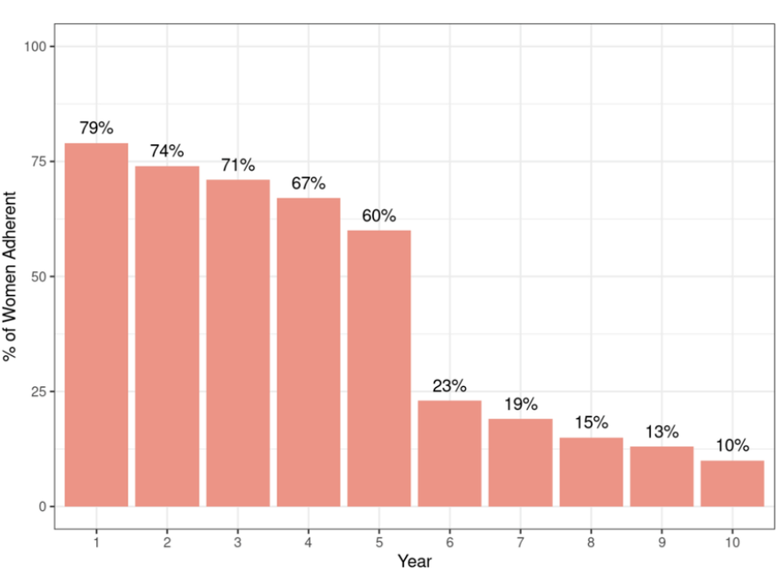
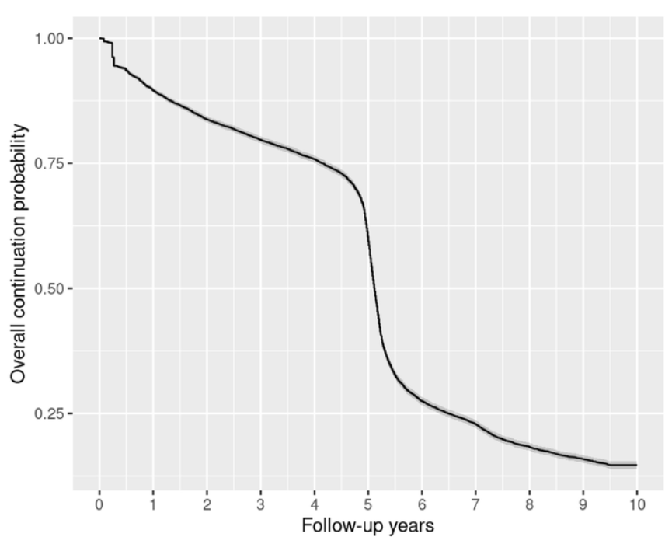
Beyond the 5-Year Mark: Adherence and Continuation of EET
Retrospective study of Kaiser Permanente patients aimed to evaluate long-term (beyond initial 5 years) adjuvant endocrine therapy (AET) adherence and continuation rates among early-stage HR+ breast cancer patients
Annual Adherence Rate:
Year 6 presents inflection point for intervention to improve adherence to AET
Median Discontinuation Time: 5.12 years
~5% discontinued within first 6 mo
52% continuing AET in year 5
20% continuing AET in year 6
4.5% in year 10
Wei J, et al. Breast Cancer Res Treat. 2025;214(2):239-246.

Slide 53
Beyond the 5-Year Mark: Adherence and Continuation of EET
Retrospective study of Kaiser Permanente patients aimed to evaluate long-term (beyond initial 5 years) adjuvant endocrine therapy (AET) adherence and continuation rates among early-stage, HR+ breast cancer patients
  Implications
  There is a dramatic decline in adherence and continuation of extended adjuvant endocrine therapy after year 5, with the inflection point at year 6¹
  This reveals a significant missed opportunity to improve long-term outcomes in HR+ breast cancer and points to year 5 as a pivotal window for intervention¹
  Genomic testing may help improve rates of adherence. In the BCI Registry Study, 82% of patients recommended for extended endocrine therapy were more likely to be compliant following BCI™ Testing²
1. Wei J, et al. Breast Cancer Res Treat. 2025;214(2):239-246. 2. Sanft T, et al. Breast Cancer Management. 2019;8(1).

