Slide 1
Transitioning to Full Field Digital Mammography (FFDM)

Slide 2
Disclaimer:
This is a general information tool for medical professionals and is not a complete representation of the product(s)’ Instruction for Use (IFU) or Package Insert, and it is the medical professionals’ responsibility to read and follow the IFU or Package Insert.
The information provided may suggest a particular technique or protocol however it is the sole responsibility of the medical professional to determine which technique or protocol is appropriate.
At all times, clinicians remain responsible for utilizing sound patient evaluation and selection practices, and for complying with applicable local, state, and federal rules and regulations regarding accreditation, anesthesia, reimbursement, and all other aspects of in-office procedures.
In no event shall Hologic be liable for damages of any kind resulting from your use of the information presented.

Slide 3
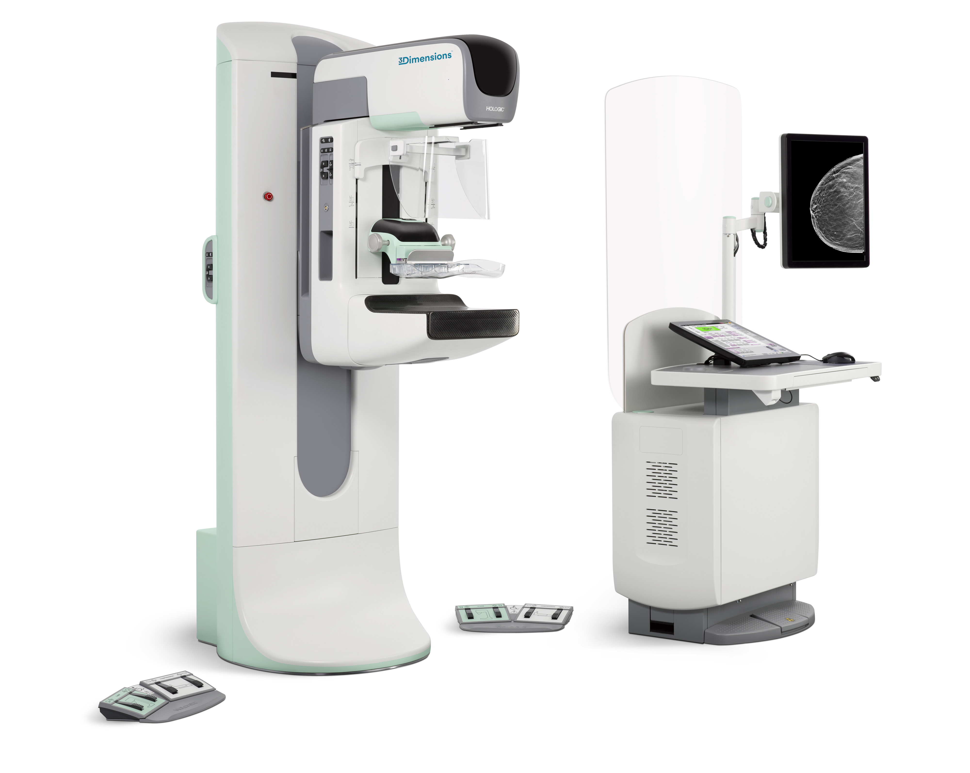
Objectives
State the fundamentals of full field digital mammography
Understand the transition from analog to digital imaging
Identify the advantages of digital mammography
Digital mammography workflow
Acquisition
Display
Storage
Radiation dose reduction
Acknowledge the differences in image quality
Notes:
Fundamentals
Processing
Display
Image Analysis
PACS
Dose Reduction and Patient Safety
Quality

Slide 4
Acronyms/Terminology
AWS: Acquisition Work Station
CAD: Computer Aided Detection
DICOM: Digital Imaging and Communications in Medicine
DWS: Doctor’s Work Station
Output: Destination for images
FFDM: Full Field Digital Mammography – 2D
Array: Image receptor/detector
Notes:
Before starting this presentation, I will share with you several different terms & acronyms that apply to full field digital mammography

Slide 5
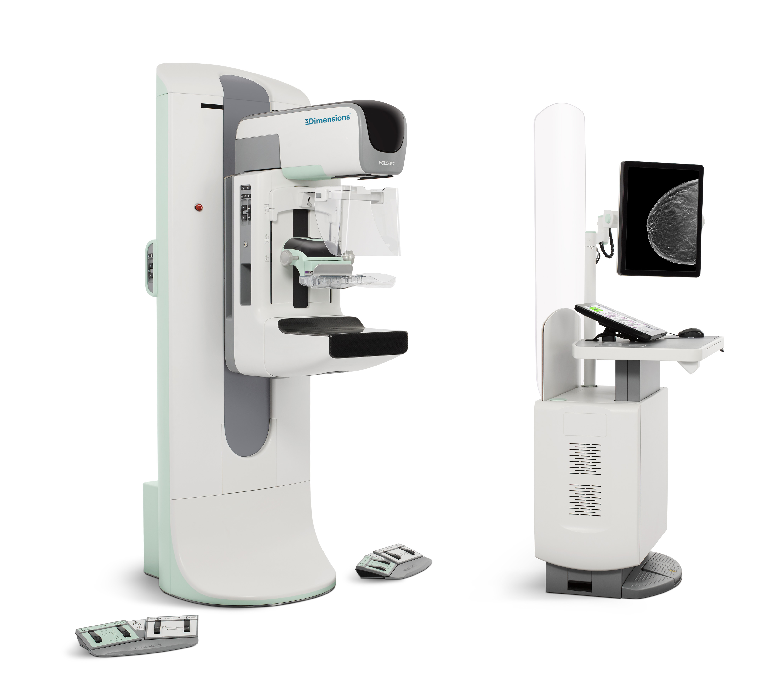
Mammography Fundamentals
Notes:
We will review the basic fundamentals of imaging the breast tissue.
The examination called mammography: x-ray images of the mammary glands.

Slide 6
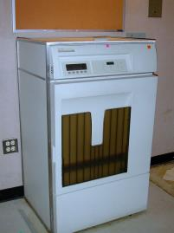
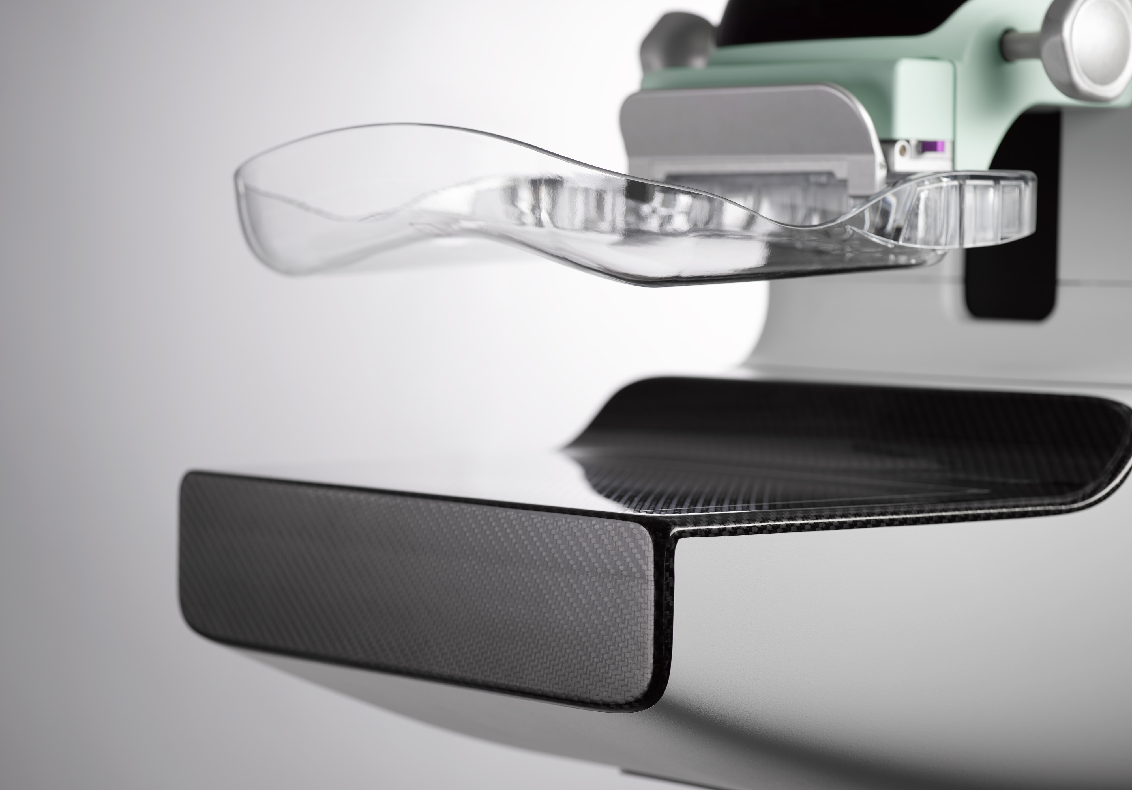
The Analog to Digital Conversion
Screen Film
Image source
Cassette
Processor
Film viewer
  Digital
  Image source
  Digital detector
  Acquisition computer
  Softcopy display
Notes:
In analog mammography, a mammography system with film & cassettes are utilized.
In full field digital mammography, a digital mammography system with a detector produces an electronic image. This image is displayed on a workstation that allows for electronic tools that can magnify, invert or enlarge.
6

Slide 7
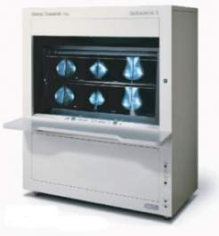
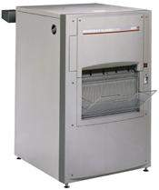

Screen film mammography – workflow
X-ray source
Film Processor
Film viewer
Screen-film cassette
1
A scintillating screen absorbs x-rays and generate light photons, which are captured on film
2
Exposed films are loaded into a wet processor and hard copy films are developed
3
Processed films are mounted on a high luminance viewer for review by a radiologist
Notes:
The fundamentals of analog or screen-film mammography require:
A mammography system with a x-ray tube & generator. The x-ray tube is molybdenum. click
A image receptor: the ‘bucky’ has a grid (to clean up scatter x-ray) and the screen-film cassette is inserted into the bucky
A x-ray exposure is created: the x-ray beam hits the screen in the cassette and produces light photons which are transferred onto the x-ray film
In a screen-film environment, the technologist has cassettes that contain one piece of radiographic film. One cassette/film is used for each mammographic view taken. click
At the end of the exam, the technologist will take the 4 cassettes from a screening exam to a film processor. The processor uses wet chemicals to develop and then dry the film. He/She will review her films on a light box. They are then placed on a viewer for the radiologist to review for interpretation.
After all the exposures, the technologist takes the cassettes into the dark room and develops the film in the wet processor
The films are then displayed on a film viewer or ‘light’ box for the radiologist to review

Slide 8
Fundamentals of Full Field Digital Mammography (FFDM)
Uses traditional X-ray generators & tubes
Softcopy review workstation with tools to manipulate images
X-ray beam converted into digital information
Image display & storage optimized independently of each other
Notes:
Full Field Digital Mammography utilizes a mammography system that has:
A traditional X-ray generators and tubes to produce an X-ray beam
This X-ray beam is converted into digital information
At the softcopy review workstation, the radiologist can manipulate the image: enlarge, measure, change brightness and contrast, add anotations
Digital Imaging allows the functions of image acquisition, image display, and image storage to be optimized independently of each other
It is a detector that captures the information instead of a cassette and film

Slide 9
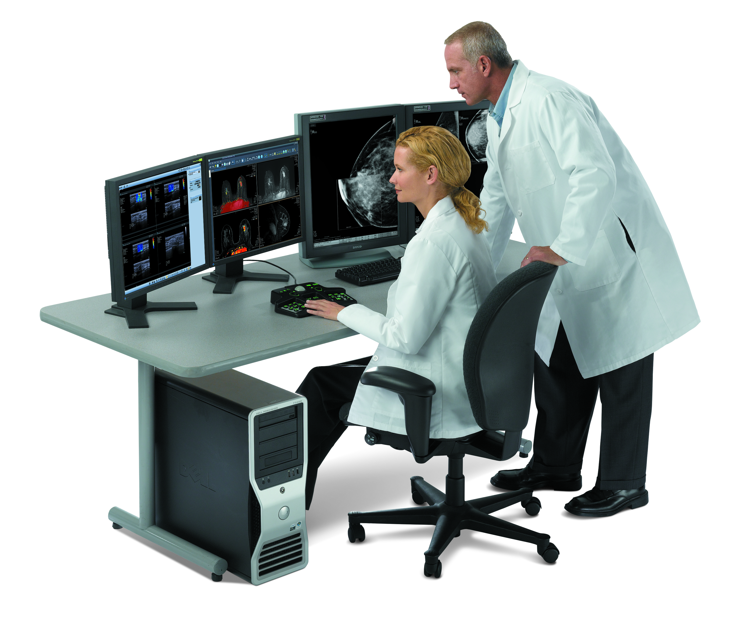

FFDM Workflow
Digital detector
Diagnostic
workstation
1
Digital detector converts X-rays into electronic signal and read out as digital image
2
Digital images transmitted to acquisition computer - display on monitors for review and acceptance by technologist
3
Accepted cases transferred directly to high resolution diagnostic workstations for review by radiologist
Notes:
A digital mammography system is used to produce the images.
It has a digital detector which converts the x-ray beam into an electronic signal and with a computer, produces the digital image.
The x-ray tube is a Tungsten tube.
The images can be stored in an archive or a PACS.
The images can also be viewed immediately by the radiologist at the workstation.

Slide 10
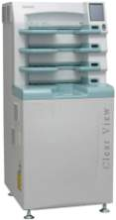
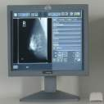

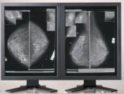
Computed Radiography (CR) Mammography
3
Images are transmitted to a monitor for review and acceptance by technologist
Analog system
2
Cassettes are loaded into a CR reader, where dual side scanning with laser lights stimulates escape of stored charges, which are released as light and converted to electronic signal
Digital cassette
1
X-rays converted to electronic charges and stored as a latent image inside the digital cassette
Accepted cases are transferred directly to high resolution diagnostic workstations for review by radiologist
4
Source: www.fuji.com
Notes:
Another method of producing an image of the breast, is to use a CR system.
An analog mammography system is used and a digital cassette is inserted into the bucky.
The cassettes are then loaded into a CR reader converts the light into an electronic signal.
The images are reviewed & accepted, then sent to a doctor’s workstation for review.
The workflow with CR is the same as analog mammography. There is no reduction of time.

Slide 11
Why Digital Mammography
Notes:
There are definite advantages to converting to a digital mammography system.
• Lower dose
• Improved image quality
• Computer-aided diagnosis
• Softcopy review and digital archiving
• Tomosynthesis and other three-dimensional visualization techniques
• Reduction in breast compression pressure

Slide 12
Analog Mammography
Advantages
Inexpensive
Captures images with high spatial resolution
Stores large amounts of information
Disadvantages
Short dynamic range
Processing time required
Large amount of physical storage space required
Must be physically transferred; only one place at a time
Notes:
Before explaining the advantages of Full field digital mammography, let’s review Analog mammography.
Listed are the advantages & disadvantages of Analog mammography.
It is relatively inexpensive and simple to use
and can capture images with high spatial resolution.
The film can store and display large amounts of information.
But there are more disadvantages:
Film/screen images have a short dynamic range
Wet processing time can be up to 2 minutes
A room to store all the film is required
Since it is film, it can only be transfer manually – film can only be one place at a time

Slide 13
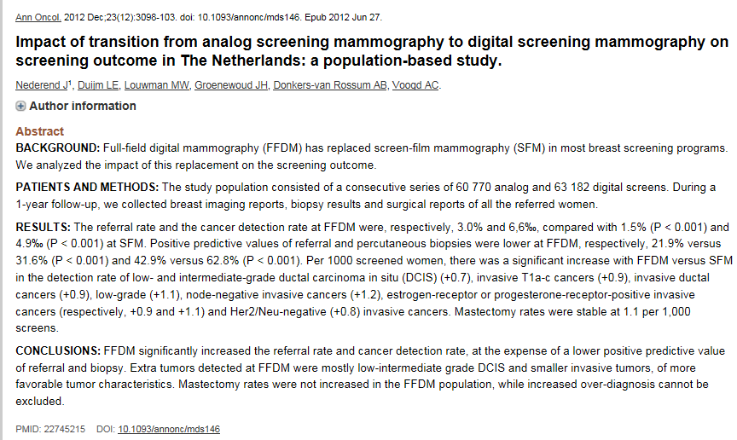
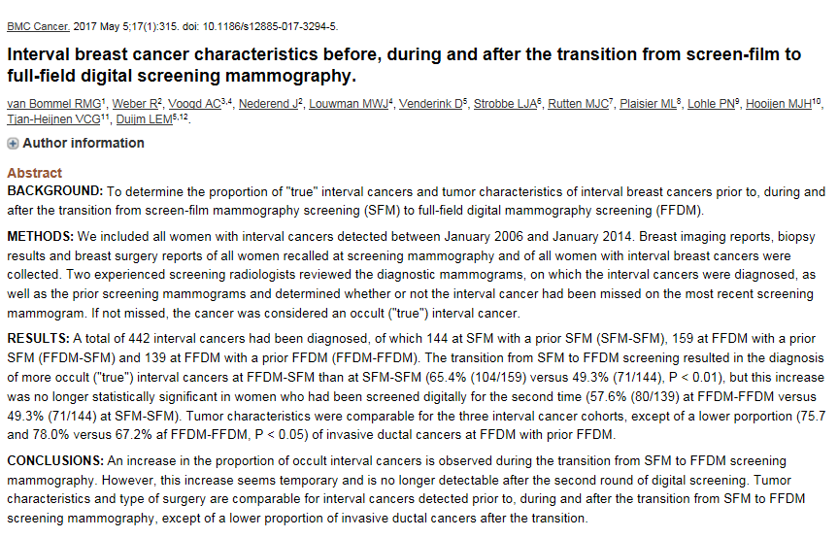
Notes:
Since the year 2000, there have been several published papers on the topic of transitioning from film screen mammography to digital mammography.
Available articles share experiences in workflow, screening outcomes as well as the increase in cancer detection.
Click x 2 to display sample abstracts

Slide 14
Advantages of Digital Mammography
Wider dynamic range
Reduced exam times
Image manipulation tools
Removes film variability
Improved image quality
Radiation dose reduction
Eliminates processing
Notes:
There are many advantages to 2D digital mammography
Improved image quality
Wider dynamic range
Reduced exam times
Image manipulation tools
Removes film variability
Eliminates processing
Minimizes retakes
Reduction in radiation dose

Slide 15
Comparison
Screen-film
Wide dynamic range
Short dynamic range
Processing time – 5 to 10 minutes
Large amount of physical storage space
Must be physically transferred; only one place at a time
No tools for advanced image review
Full field digital
No processing time
No physical storage space required – archive only
Images may be transferred to multiple locations electronically
Multiple image manipulation tools
Notes:
Screen film mammography does not provide the image quality nor efficient workflow.
Full field digital mammography has a wider dynamic range which provides better contrast over a wider range of intensities and a lower noise level
There is no processing time and images display within a few seconds
An archive system or PACS will store studies electronically and it is more cost effective method
Electronic sharing of studies is possible from facility to facility
The radiologist may manipulate the image

Slide 16
Clinical Advantages
2005 – DMIST study
Demonstrated statistically significant improvement in breast cancer detection in 65% of the study population:
Age <50 with all breast densities
Pre– or perimenopausal women of any age
All ages with heterogeneously (very dense) or extremely dense breasts
Current FFDM systems provide major technological advances over systems used in DMIST
Notes:
DMIST study, using first generation systems, demonstrated statistically significant improvement in breast cancer detection in 65% of the study population:
In 2005, a study was conducted to compare full field digital mammography to screen film mammography.
49,500 women participated; each patient had a digital and a screen film mammogram.
The results showed an increase in breast cancer detection & the reduction of radiation dose to the patient.

Slide 17
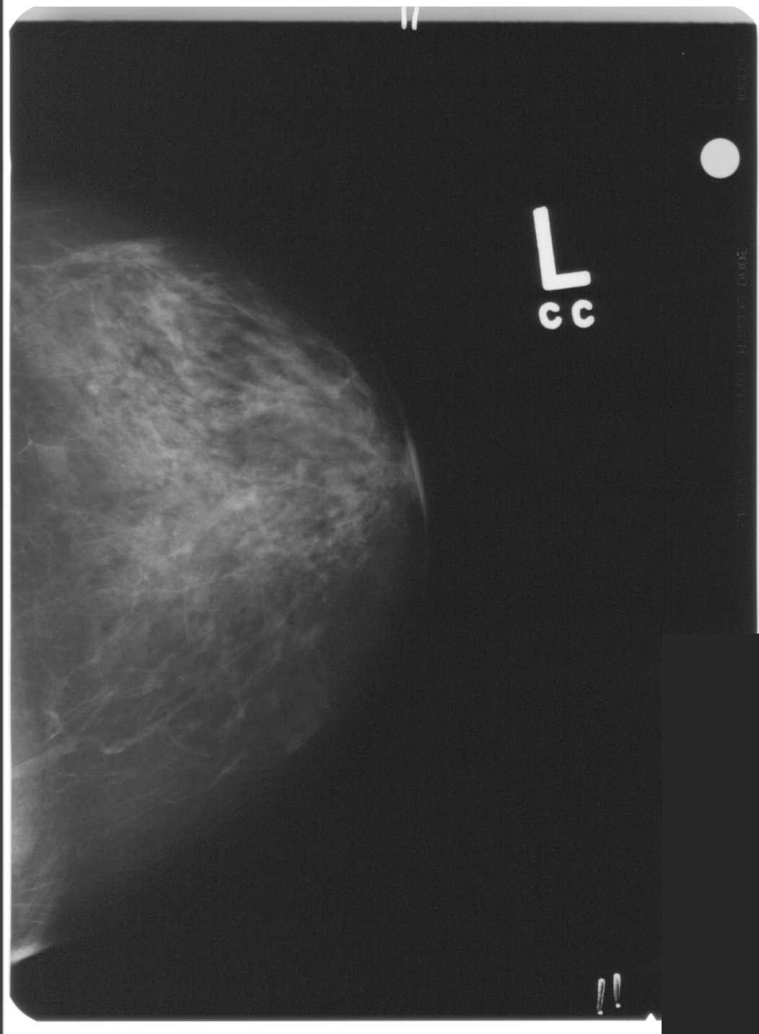
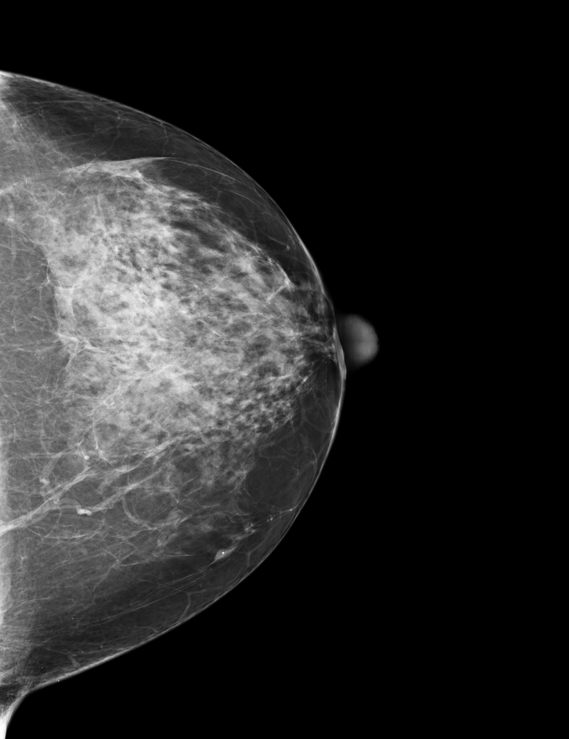
Improved Image Quality
Notes:
The left image is an analog film image and the right image is the FFDM image.
Please notice the difference in image quality.

Slide 18
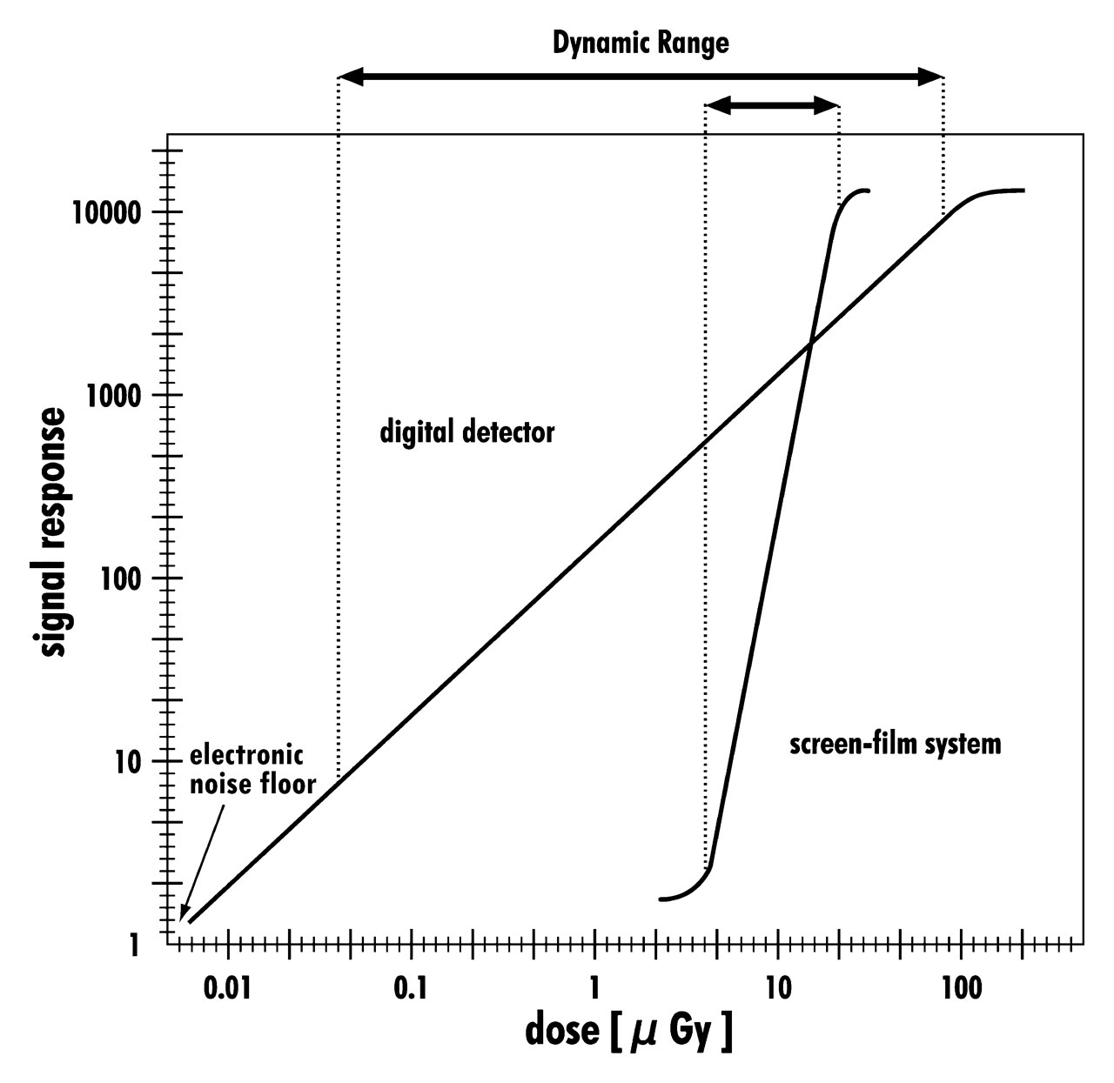
Dynamic Range
Notes:
Film has a low tolerance for an exposure that is higher or lower than required
Results in a failed exposure
Digital has a wider dynamic range
Decreases the need for failed exposure
Difference in tissue can be captured on one image

Slide 19
Radiation Dose
Notes:
My next slide will cover information concerning patient radiation dose

Slide 20
Digital mammography exposures
AEC - the pixels become the photocells
A preliminary exposure assesses tissue density and thickness,
The algorithm controls contrast vs. kVp
Adequate and appropriate kVp should still be applied
Dose is still a factor of mAs
AEC: Automatic Exposure Control
Then applies the needed exposure technique
FFDM uses higher kVp than film = lower dose

Slide 21
Patient Radiation Dose
mGy
*Based on the U.S. average dose of FFDM, S/F and CR as collected from medical physicist’s’ dose measurements available at the time of MQSA inspections Jan – Sept 2012.
Notes:
Radiation Dose is measured by using a phantom; the values displayed are based on exposures using the American College of Radiology (ACR) phantom. The values are per a single exposure.
Screen film systems have a molybdenum x-ray tube while most digital systems have either a molybdenum or tungsten x-ray tube. The use of a tungsten reduces the patient dose.
In the United States, the government has put a limit on the amount of radiation dose per exposure; it is 3 mGy.

Slide 22
Why is dose lower for FFDM?
DQE: Detective Quantum Efficiency: efficiency of detector in converting x-ray energy into image signal
High DQE values indicate less radiation is needed to achieve identical image quality
Ideal detectors would have a DQE of 1 (all of the radiation energy is absorbed and converted
DQE = film range .1-.3
DQE = digital .45
Notes:
Dose per image:
Same dose= better image quality
Less dose= same image quality
Dose per patient:
Fewer repeat images

Slide 23
Digital Mammography Workflow

Slide 24
Exam Time
Screen Film
Technologist takes cassettes out of room to develop
Film has to develop before review
Patient is left alone in room
Digital imaging
Fast image evaluation – within seconds of exposure
No film developing
Patient can be repositioned if repeat is needed
Patient leaves after image quality check

Slide 25
Procedures
Needle localization
Immediate image review improve technique & procedure time
Subtle adjustments to wire position can be made very quickly
Decreases likelihood for bad patient experience/outcomes
Stereotactic biopsy
Faster workflow allows for shorten procedure time
Rapid review of images decreases risk of patient movement = increased accuracy
Reduce time for patient under compression

Slide 26
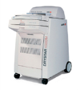
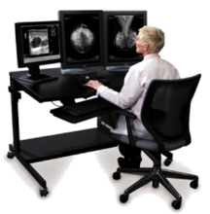
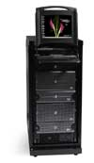

Full Field Digital Mammography workflow
Film
Printer
CAD
PACS
FFDM System
Radiologist workstation
Notes:
The actual “flow” or transfer of the image data.
*click x 4 to display arrows pointing to the other products

Slide 27
Economic Advantages
Increased patient throughput compared to screen-film and CR
6 or more screening exams/hour may be completed easily using digital mammography, as compared to 3 - 4 with screen-film & CR mammography
Needle localizations can be completed much faster
Fewer exam rooms needed for comparable patient volume
Elimination of costs associated with film, processors and storage, included labor for filing and retrieval of films
Notes:
There are economic advantages for utilizing FFDM.
More screening mammography exams can be completed:
6 or more screening exams/hour may be completed easily using digital mammography, as compared to 3 - 4 with screen-film and CR mammography
Needle localizations can be completed much faster
Because of a faster throughput of exams, fewer exam rooms are needed
Costs for film, processor maintenance, storage and labor to manage film is eliminated

Slide 28
DICOM
Digital Imaging and Communications in Medicine
The standard for transferring images and data among PACS / print devices
The most common format for image storage
Notes:
A standard for acquiring, storing, printing and transmitting medical imaging information.
Enables interoperability between components such as modalities, scanners, workstations and printers.

Slide 29
Image Storage
Digital images are stored in a PACS system
Disks are generally not considered a reliable method of storage
PACS is an acronym for Picture Archiving and Communications

Slide 30
Softcopy Review Workstation
Notes:
At the radiologist’s workstation, the mammography images can be reviewed.
Workstations allow for manipulation of the images:
changing the brightness and/or contrast
Magnifying a specific area
Additional tools for measuring or annotating areas is available.
These tools are the ‘wax pencil’ from the screen-film days.

Slide 31
Softcopy Review Advantages
Digital images are reviewed on high resolution, medical grade monitors, for optimal viewing conditions
Softcopy review allows the radiologist to:
Zoom in and magnify areas of interest
Adjust contrast and brightness for better visualization of fine details
Display digital images from prior studies
Arrange images on screen for best comparison
Use measuring tools
Create and store annotations

Slide 32
Telemammography
The ability to transfer images to off site locations leads to efficiencies not achievable in film mammography
Consolidation of specialist radiologists to read screening mammography
Efficiencies in having prior films
Batch reading
Decrease personnel to hang films

Slide 33
Other Advantages
Elimination of lost films
Redundant storage of digital exams eliminates possibility of lost images
Foundation for other advanced applications
Breast tomosynthesis
Contrast enhanced digital mammography
Biopsy guidance with tomosynthesis

Slide 34
Image Review
Notes:
Now I would like to show you a comparison between analog or screen-film images and full field digital images.
The all analog images will be on the left side with the digital images on the right.

Slide 35
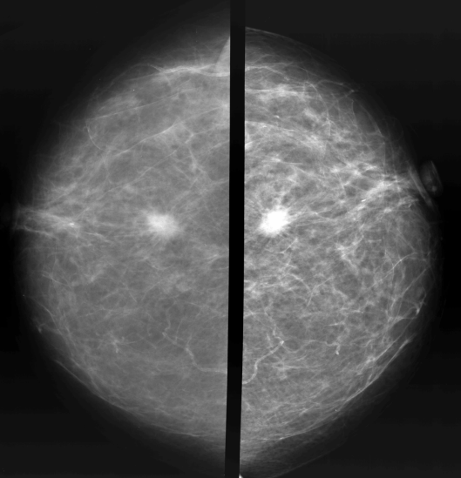
Spiculated Mass
Notes:
Let’s take a look at some clinical images. The screen-film images will be on the left and the digital images on the right.
PowerPoint only uses about 1 million pixels for displays. These digital images contain 15 million pixels, so many of the dramatic differences can not be displayed using PowerPoint. In addition, PowerPoint can only display a limited number of shades of grey, significantly less than in the original digital mammographic images.
We can see differences in the overall appearance of these images with the digital images on the right exhibiting much more contrast and image sharpness. In addition, on the workstation one can readily see the skin line of the digital images— which is completely lost of the screen-film images.
Next let us zoom in on the spiculated lesion—

Slide 36
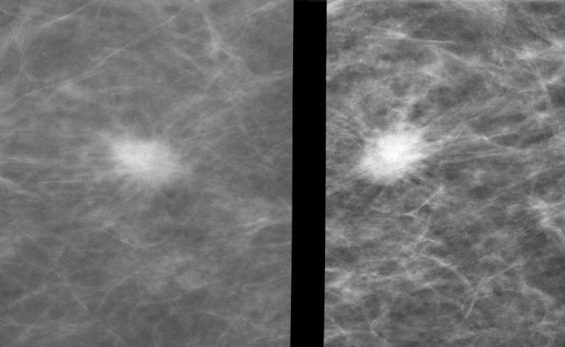
Spiculated Mass
Notes:
The spiculations around the lesion are more clearly seen on the digital image, as well as other detail associated with the periphery of the lesion. In addition, we can see structural details in the lesion on the digital images which are nor apparent on the screen-film image.

Slide 37
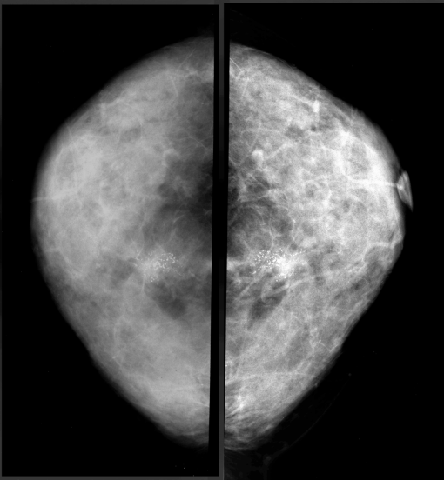
Calcifications
Notes:
This dense breast is an excellent example of how digital mammography (on the right) can improve the visualization of detail which is typically lost in screen-film imaging. Note all of the details that are not visible in the screen-film image on the left but are clearly visible with high contrast on the digital image.
Note the cluster of microcalcifications which we will take a look at using software magnification…

Slide 38
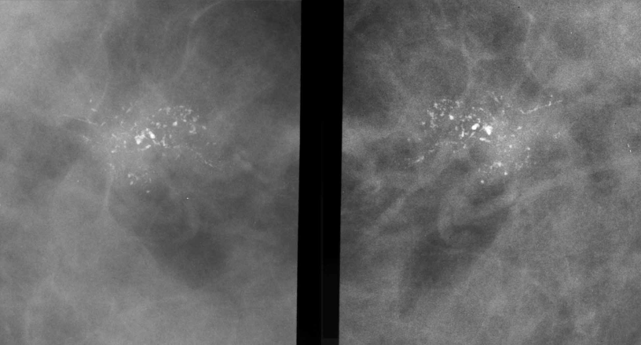
Calcifications
Notes:
The difference in the morphological features is quite stunning. More calcifications are visible on the right in the digital image. In addition, take a look at the difference in the fine line of calcium in the upper right portion of the image on the right and compare its appearance to that of the same structure in the upper left portion of the screen-film image on the left. Features are visible in the digital image which are missing in the screen-film image.

Slide 39
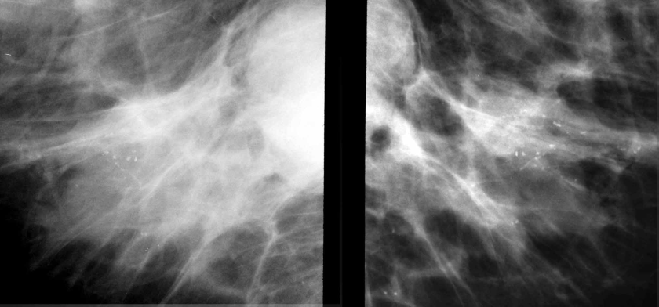
Microcalcifications
Notes:
The clarity of the microcalcifications on the right in the digital image is impressive compared to those in the screen-film image on the left. Furthermore, there is much more information in the dense portions of the breast on the digital image compared to the screen-film image.

Slide 40
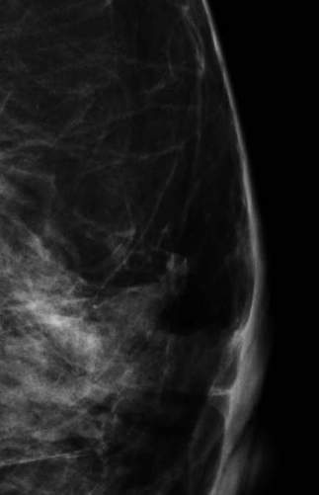
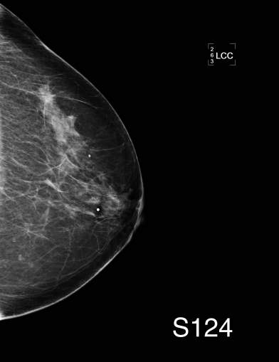
Digital Magnification

Slide 41
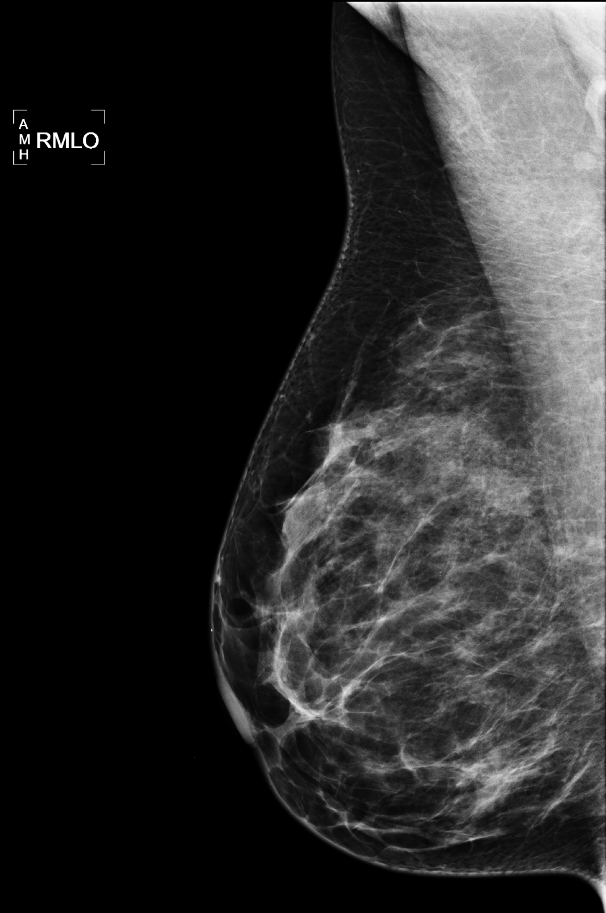
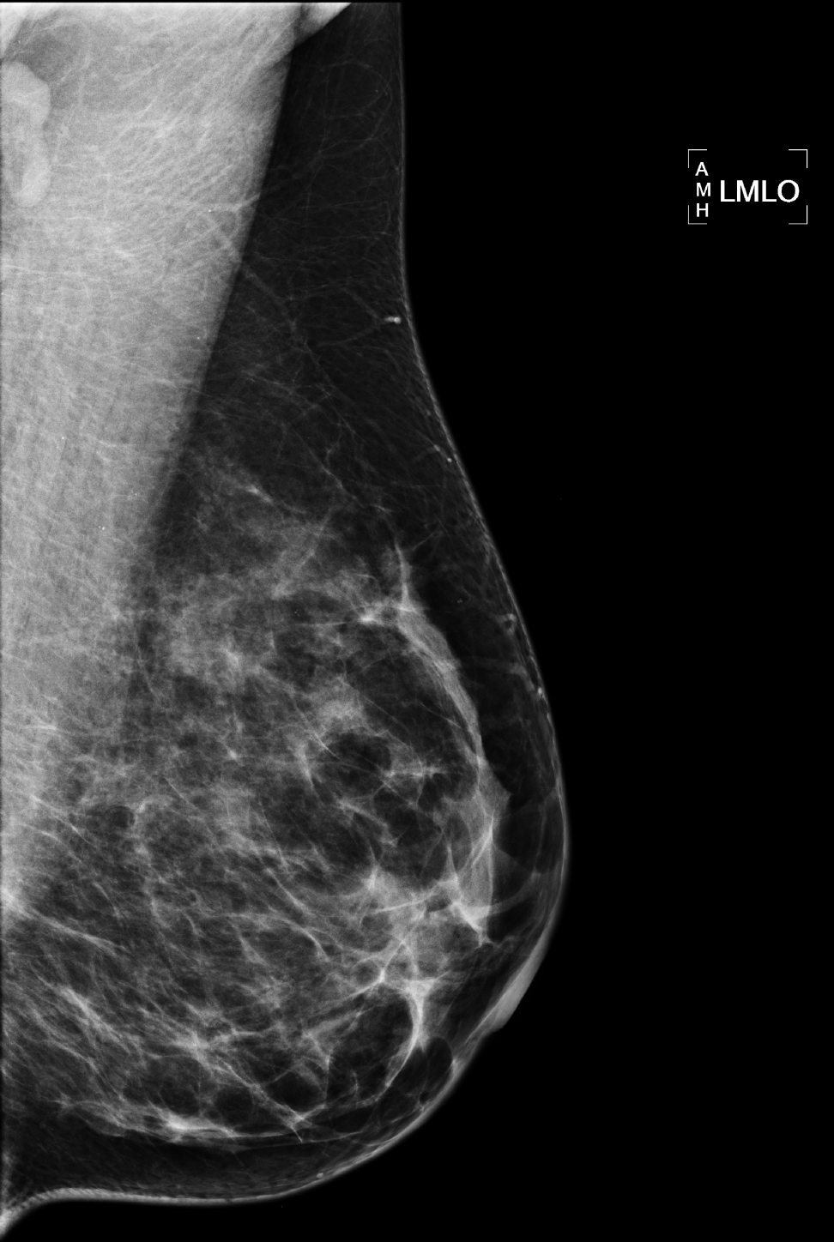
Superb Image Quality
PCE Off
PCE Applied
Notes:
Part of our proprietary image processing software includes Peripheral Contrast Enhancement. This feature applies contrast enhancing algorithms to provide better visualization of tissue at the skin line. Unlike competitive systems, optimal contrast is calculated and applied across the entire breast, taking into account different tissue densities throughout the breast.
With competitive systems, the contrast selected for optimal visualization at the skin line is applied across the entire breast, with no adjustment for different tissue densities.

Slide 42
Benefits of Full Field Digital Mammography
Image manipulation post acquisition
Unlimited access to original
Reduction in dose
Faster workflow
Cost reduction
Notes:
Digital mammography allows radiologists the ability to manipulate the images and use all the tools computer technology can provide. They can now window and level, magnify, measure, invert and so much more.

